Slide 1
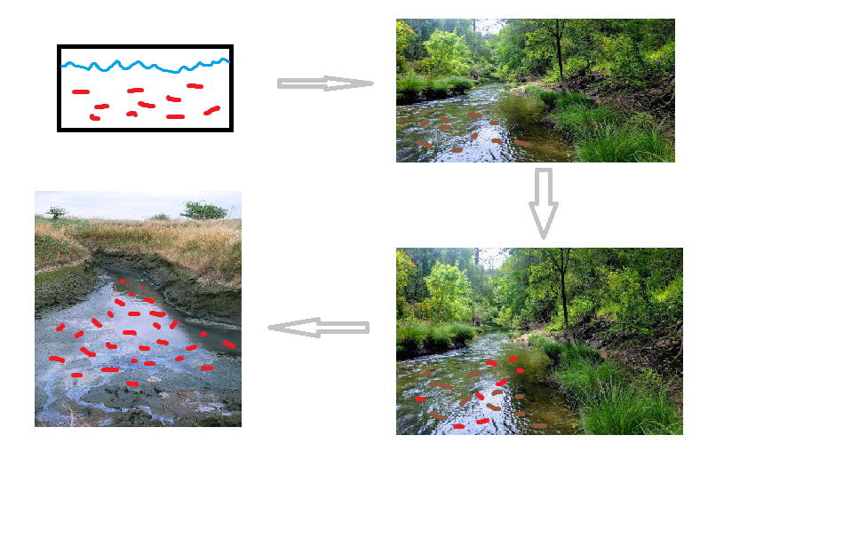
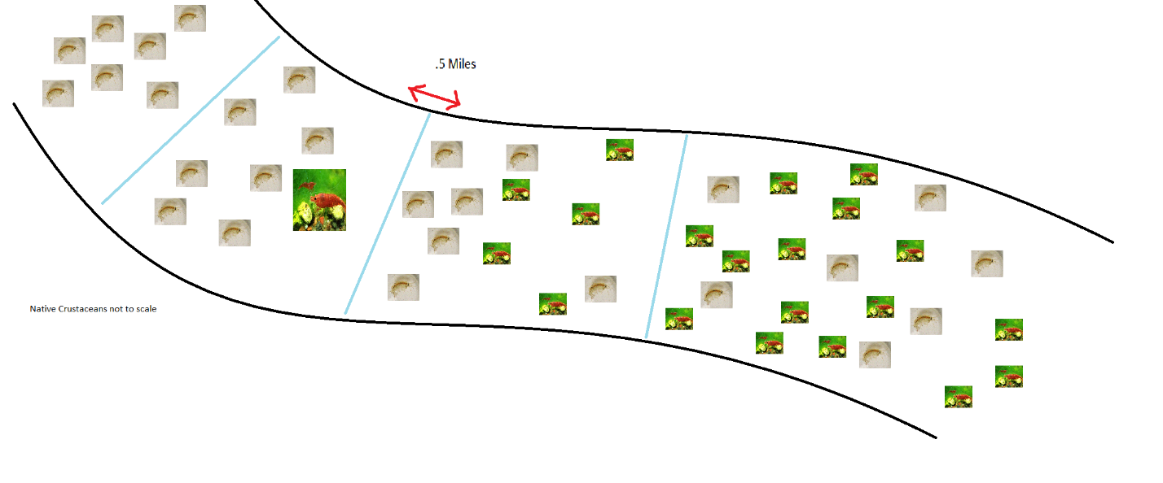
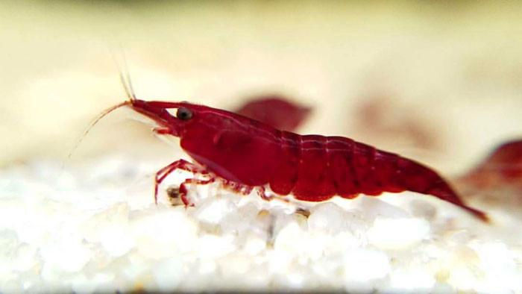
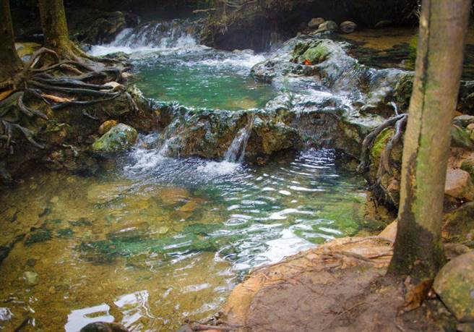
If aquarium shrimp are released into a body of water, will they out-compete other native crustaceans?
David Battit, University of Vermont
Background
Study Design
Red Cherry Shrimp (neocaridina Davidi) are one of the most popular aquatic shrimps in the aquarium trade, and they are native to tropical bodies of fresh water in Taiwan. They’re loved by aquarists not only because of their stunning ruby red color, but because they are remarkably hardy and can easily adapt to a wide range of water parameters. Because of this, they are capable of surviving in even the least favorable aquatic environments (there are reports of shrimp reproducing inside aquarium filters that they were sucked into). Given their aptitude for surviving and reproducing in unordinary environments, these shrimps could begin to resemble invasive species. (Knowl. Manag. Aquat. Ecosyst. 2019)
The health of aquatic ecosystems relies largely on the predominance and abundance of its native species. If red cherry shrimp are so capable of surviving in foreign bodies of water, it is possible that they could throw the health of that ecosystem askew by outcompeting the other local aquatic crustaceans.
The study should be carried out in an area that stays relatively warm throughout the year to ensure that the cherry shrimp will survive, and their impacts can be measured. It will have to be done in separate bodies of water for different trials. These bodies of water should all be the same, so for the sake of this experiment we will use slow-moving streams (slow moving = no visible surface ripple). One stream (plot 1) will not be modified to be used as a control, where the ecosystem productivity is high and native crustaceans (scud, crayfish) are plentiful. A second stream (plot 2) similar in nature will have only 2 cherry shrimp added and monitored. A third stream (plot 3) will have 10 added, and a fourth (plot 4) will have 30. This way we can monitor how quickly the shrimp begin to affect the ecosystem. As to not potentially ruin that many streams, this study can be done in just one stream so long as the plots are properly spaced. The top of the stream can be the control, half a mile downstream could be plot 2, etcetera. This would prevent the cherries from travelling upstream and contaminating the control plot, while separating them sufficiently to be deemed independent.
Figure 1. A simple model illustrating the potential for red cherry shrimp to remove native species from their own ecosystem. Brown marks are native and red marks are invasive. Pictures in works cited.
Figure 2. The hypothesis, visualized. It is a simple comparison between the number of individuals from each species. It is assumed that the ecosystem has a maximum carrying capacity of 100, and 30 shrimp were introduced originally via irresponsible aquarist.
Motivation
Cherries have been popular for some time now, with the first non-native population discovered in 1991 in Oahu, Hawaii, where they are now widespread. With their reproduction left unchecked, biologists began to fear that they would compete with not only native crustaceans, but native insects. Thriving populations were also discovered in Japan, but more surprisingly in both German and Polish rivers. These rivers had power plants discharging warm water year-round, so their presence was justified easily. More concerning though is a colony found in a German pond after the pond froze over for the winter. With the earth heating and cold bodies of water warming up, these shrimps could dominate entire ecosystems.
We aim to evaluate the ecological danger presented by the release of red cherry shrimp by quantifying their ecological impact on non-native bodies of water.
Figure 4. A model of the proposed experiment.
Analysis
Figure 3. The predicted ecosystem productivity of 3 scenarios: one healthy ecosystem, one with introduced species, and one with the introduced species dominating.
The dependent variable (ecosystem productivity) is continuous, as biofilm can be measured by mass per square inch per day. The independent variable (number of starting shrimp) is categorical. Because of this, the ANOVA test will be used to evaluate findings. The results of the ANOVA test will be used to determine if cherry shrimp negatively impact biofilm levels and therefore ecosystem health at all, and if they do, then exactly how badly.
Hypothesis
It is hypothesized that there is a negative relationship between introduced cherry shrimp and the native crustaceans they encounter. If the shrimp become dominant in an ecosystem, it is hypothesized that the ecosystem’s productivity will be negatively affected as well.
Outcomes
Predictions
Climate change is expected to continue raising yearly global temperatures, including not only atmospheric temperatures but aquatic ones too. This presents a unique situation where habitats will be made increasingly optimal for invasive species that prefer more temperate to tropical conditions, including the red cherry shrimp. This study could preemptively document the effects that cherry shrimp have on stream health in order to increase the general understanding of how streams could be impacted in the future, and perhaps to form a comprehensive plan on how to keep stream ecological productivity up while fending off invasive species.
It is predicted that as the number of non-native red cherry shrimp increase, the number of native crustaceans will decrease due to resource competition. It is also predicted that due to this invasive competition, the total productivity of the ecosystem will be negatively impacted, measured by the amount of biofilm present on aquatic surfaces. A healthy ecosystem will have plentiful biofilm to support microbiota and small crustaceans. In a body of water where the cherry shrimp have become invasive, there will be less biofilm due to their increased consumption.
Works Cited:Lynch, B. (2020, January 23). Beavers more than just cute creatures for Sonoma Creek. Retrieved November 30, 2020, from https://legacy.sonomanews.com/opinion/10591010-181/bill-lynch-frankly-my-beaver
Polluted Stream by Robert Brook/science Photo Library. (n.d.). Retrieved November 30, 2020, from https://fineartamerica.com/featured/1-polluted-stream-robert-brookscience-photo-library.html
Richard Pallardy Earth.com staff writer. (2018, August 20). Red invasion: The rise of the Red Cherry Shrimp • Earth.com. Retrieved November 30, 2020, from https://www.earth.com/news/red-cherry-shrimp/
State of the climate: 2020 on course to be warmest year on record. (2020, October 22). Retrieved November 30, 2020, from https://www.carbonbrief.org/state-of-the-climate-2020-on-course-to-be-warmest-year-on-record
Weiperth, A., Gábris, V., Danyik, T., Farkas, A., Kuříková, P., Kouba, A., & Patoka, J. (2019, February 14). Occurrence of non-native red cherry shrimp in European temperate waterbodies: A case study from Hungary. Retrieved November 30, 2020, from https://www.kmae-journal.org/articles/kmae/abs/2019/01/kmae180120/kmae180120.html

