Slide 1
Shirley Temple Timeline
Julian Siegel

Slide 2
April 23, 1928
Shirley Temple is born in Santa Monica, California to a banker and a homemaker.

Slide 3
1931
In her early childhood, Temple loves to sing and dance, so at the age of 3, her mother enrolls her in her first dance class. It was at one of these classes that Temple is first noticed by a Hollywood talent scout, which begins her career in film. While her first films are unsuccessful, by 1933 she is signed by Fox and is shot to fame through their marketing and media prowess.

Slide 4
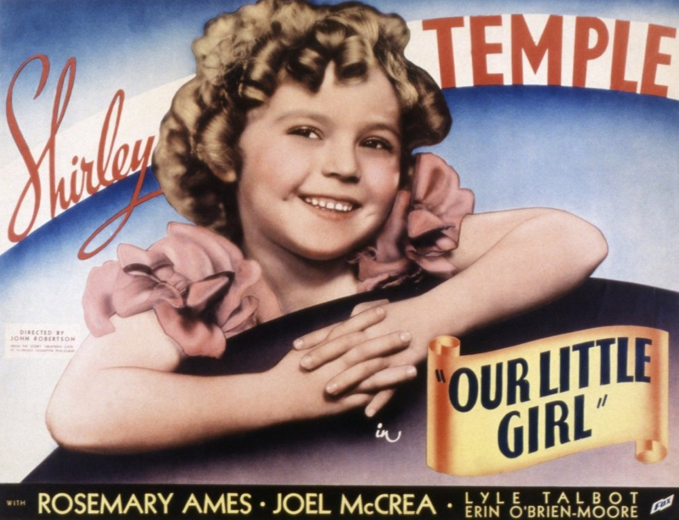
1935 Shirley Temple in ‘Our Little Girl’
Our Little Girl. Everett Collection, 1935, https://www.amazon.com/Posterazzi-Shirley-Copyright-Reserved-Courtesy/dp/B07GX25PTJ.

Slide 5
1935-1938
Despite these being Temple’s most successful years, wherein she becomes a cultural icon and the face of young girls in the United States, she remains relatively underpaid compared to other actors and actresses of the time. Her parents are her biggest advocates and help her create merchandise and other materials to capitalize on her immense popularity.

Slide 6
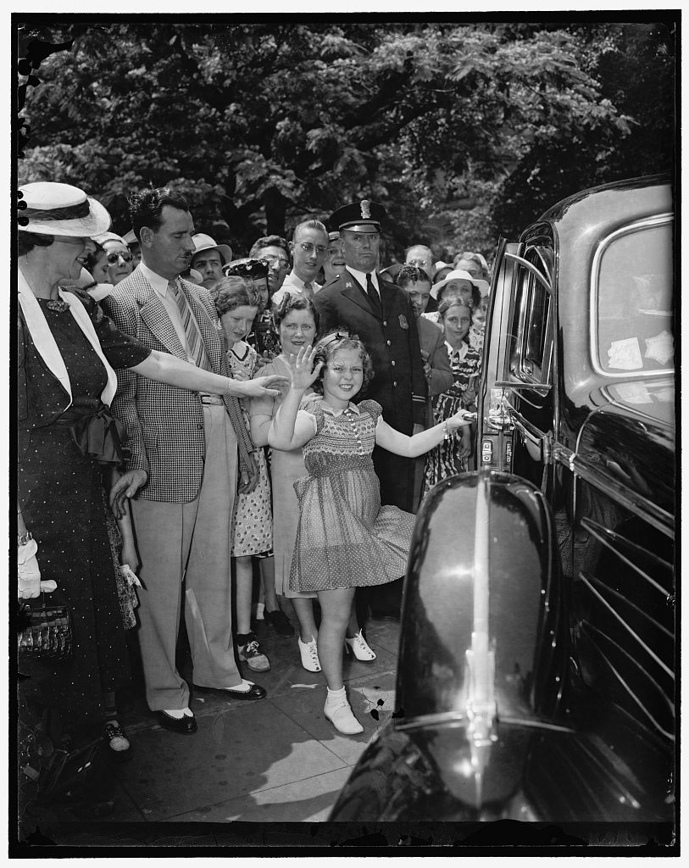
June 24, 1938 Shirley Temple After a Visit to the Whitehouse
Shirley sees her old friend the president. 24 June 1938. LOC Pictures, Harris & Ewing, https://www.loc.gov/pictures/item/2016873746/.

Slide 7
1940s-1990s
Temple’s star wains as she ‘ages out’ of her child actor position, but because of the work of her parents, she remains influential in television and film throughout her young adulthood. Eventually, she transitions away from the entertainment industry and into politics. She joins the Republican Party, runs for US Congress unsuccessfully, and becomes an influential governmental official under Gerald Ford, Jimmy Carter, and George H.W. Bush.

Slide 8
1950 Temple Marries Charles Aldan Black. They will Remain Together until his Death in 2005.

Slide 9
October 13, 1976 Shirley Temple in Her Work as a government Official
Marion, Trikosko. Chief of Protocol of the United States Shirley Temple Black. 13 October 1976, https://www.loc.gov/pictures/item/2024630553/.

Slide 10
February 10, 2014
Shirley Temple dies at her home in Woodside, California, She is 84.

