Slide 1
Jackie Coogan Timeline
Julian Siegel

Slide 2
October 26, 1914
Jackie Coogan is born in Los Angeles, California. His parents are both vaudevillian actors and by the age of 4, he is already touring with them. At 5, he is discovered by Charlie Chaplin and given his first movie role in ”A Day’s Pleasure”.

Slide 3
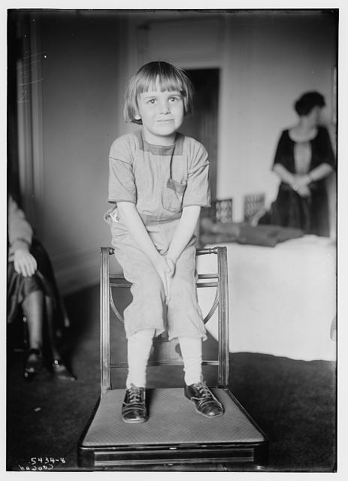
1915-1920
Jackie Coogan between the Ages of 3 and 7
Coogan. Bain News Service, 1915-1920, https://www.loc.gov/pictures/item/2014712388/.

Slide 4
1921
Coogan stars in “The Kid” with Charlie Chaplin, his biggest film by far. He enters the peak of his career as a child actor, which lasts until 1927. His parents continue to control his assets.

Slide 5
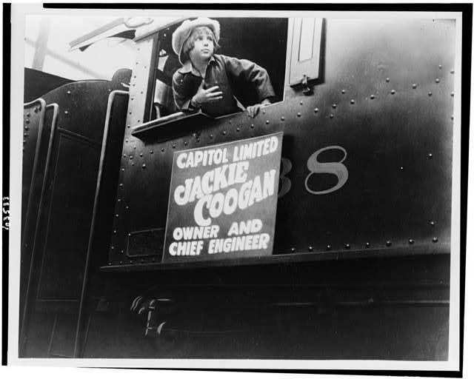
1924
Coogan promotes train line: Notable for his influence over monetary prospects for companies
Jackie Coogan leaning out of window of locomotive. 1924, https://www.loc.gov/pictures/item/91783779/.

Slide 6
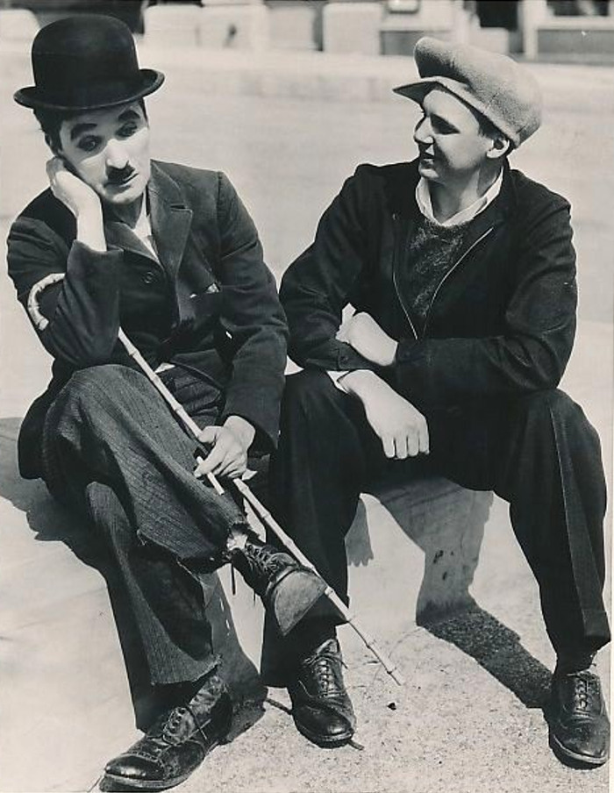
March 26, 1935
Coogan with his former costar Charlie Chaplin
Charlie Chaplin & Jackie Coogan Reenact “The Kid”. Acme, 26 March 1935, https://stuffnobodycaresabout.com/2023/01/31/classic-hollywood-141-charlie-chaplin-jackie-coogan/.

Slide 7
1935
After the death of his father, Coogan seeks to gain back the money he has earned from his successful but short child acting career. His mother and stepfather refuse, and he sues them for 4 million dollars (over 90 million today). He only receives around 100,000 because no laws in California at the time required parental guardians to provide this money to their children. This suit sets in motion major legislation

Slide 8
1939
The California Child Actors Bill, or the Coogan Act, is made law by the California State Government. This law requires that the guardians of child actors within the state of California set aside at least 15% of the monetary gains made by their children into a bank account that the child will be able to access once they turn 18. This account is called the Coogan account.

Slide 9
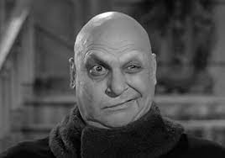
1964
Jackie Coogan revitalizes Career with His role as Uncle Fester in “The Addams Family”
Jackie Coogan - Biography. (n.d.). IMDb. Retrieved December 9, 2024, from https://www.imdb.com/name/nm0001067/bio/

Slide 10
March 1, 1984
Jackie Coogan dies of a heart attack at the age of 69. He was never able to fully regain the amount of money taken from him after his years as a child star.

