Slide 1
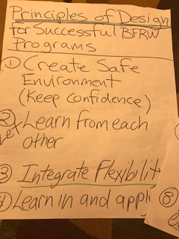
Principles of Design for Successful BFRW Programs
Create safe environment (keep confidence)
Let learners learn from each other
Integrate flexibility
Learn in – and apply to – real life contexts
Provide opportunities for reflection
Develop trust
Use role models and mentors to learn from experience
Follow up after learning event

Slide 2
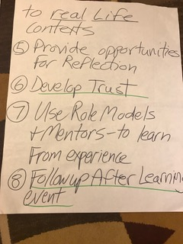
Principles of Design for Successful BFRW Programs, continued
Create space for everyone that reduces power dynamics
Support women in taking on leadership roles
Provide connections to experts/specialist/resources
Use hands-on learning
Create opportunities for adopting new perspectives – challenge assumptions
Ongoing design - not “one-and-done”

Slide 3
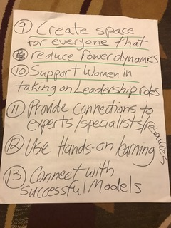
Principles of Design for Successful BFRW Programs, continued
Provide support
Child enrichment
Provide inter-generational learning

