Slide 1
Moving towards better programs: Legal Issues

Slide 2
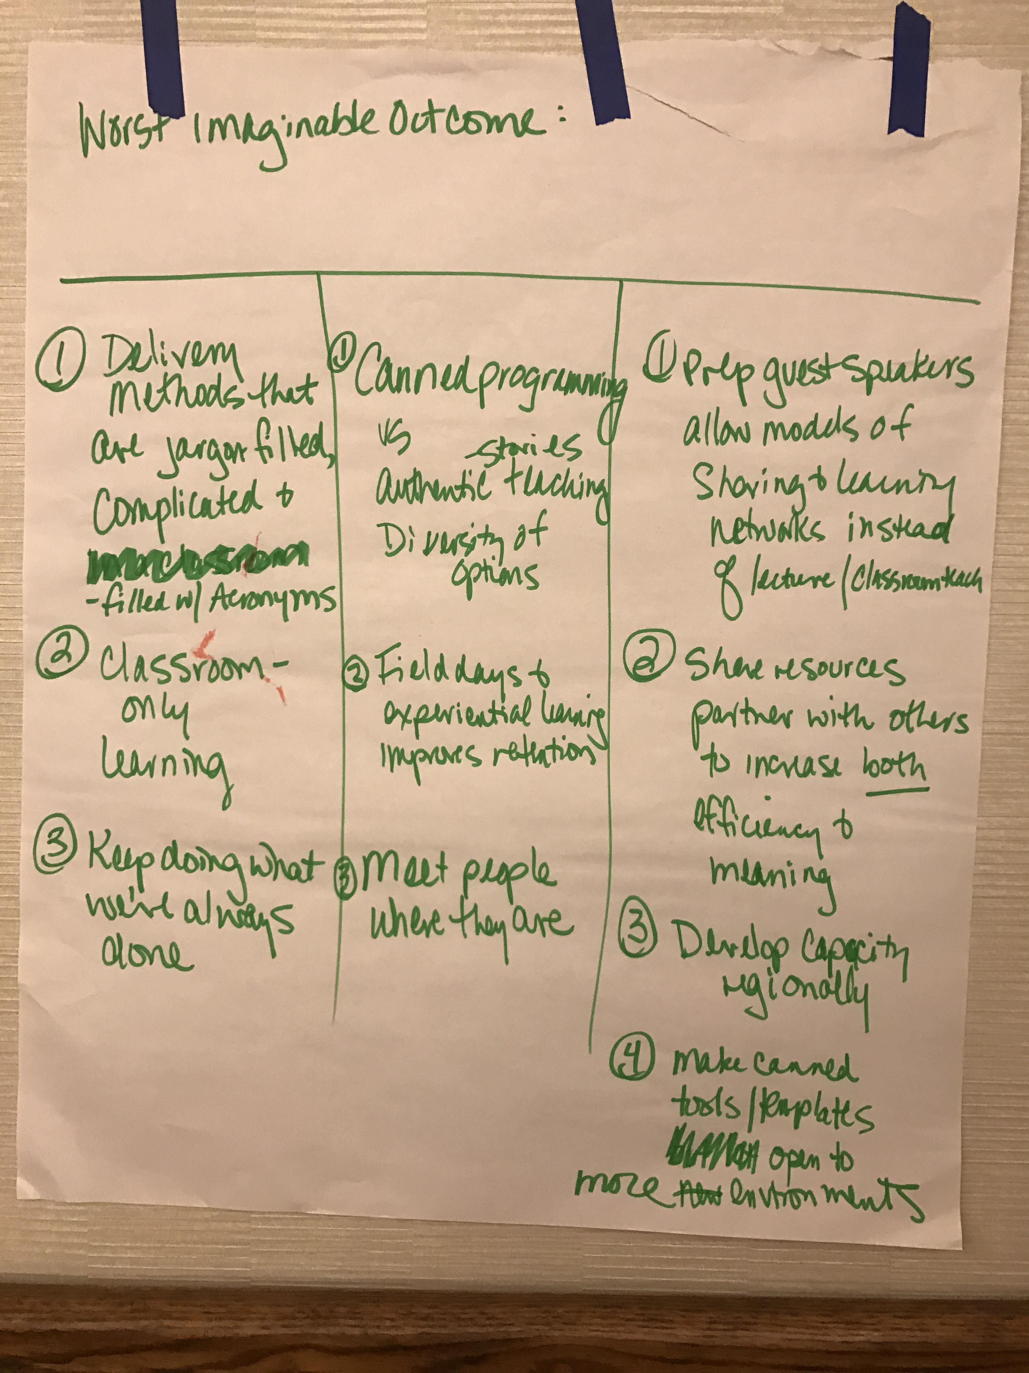
Moving Towards Better Programs: Scale & Profitability

Slide 3
Moving towards better programs: Land Access, Tenure, Stewardship
Notes:
Stop
Endless powerpoints
Information overload
Cultural insensitivities
Not knowing your audience
Why Stop?
Mind numbing
No knowledge retention
First steps to stop
Relearn presentation – facilitate, not present
Know your audience
Be willing to adapt to suit audience
Half present, half activity

Slide 4
Moving towards better programs: Land Access, Tenure, Stewardship
Notes:
Stop
Endless powerpoints
Information overload
Cultural insensitivities
Not knowing your audience
Why Stop?
Mind numbing
No knowledge retention
First steps to stop
Relearn presentation – facilitate, not present
Know your audience
Be willing to adapt to suit audience
Half present, half activity

Slide 5
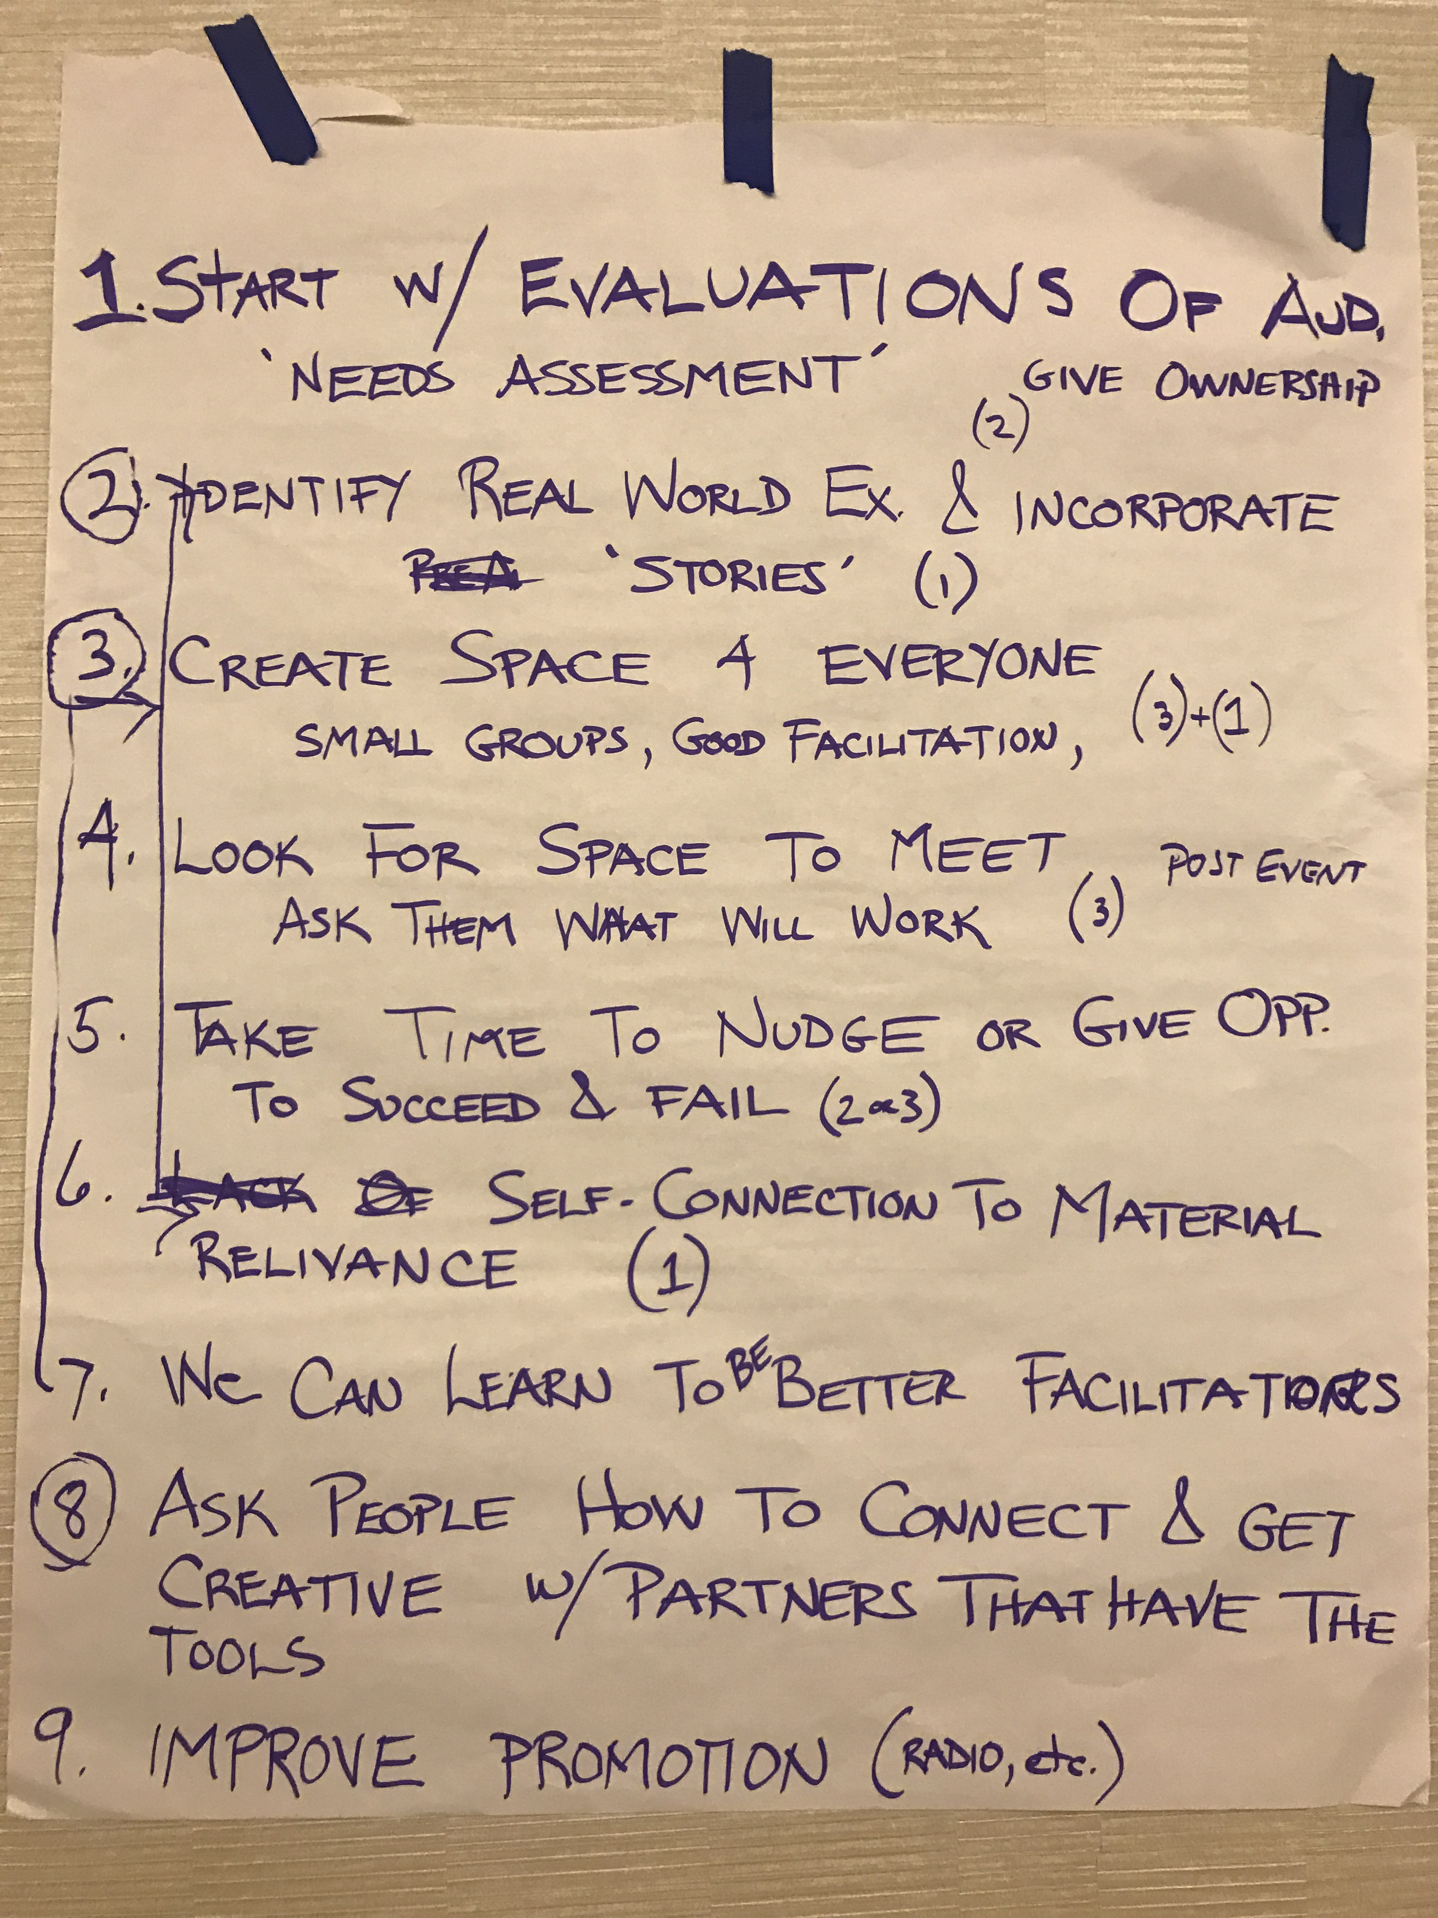
Moving towards better programs:
Notes:
Stop
Endless powerpoints
Information overload
Cultural insensitivities
Not knowing your audience
Why Stop?
Mind numbing
No knowledge retention
First steps to stop
Relearn presentation – facilitate, not present
Know your audience
Be willing to adapt to suit audience
Half present, half activity

