Slide 1
The Theremin as a Revolutionary Instrument
By Elle Cunningham and Matt Jackson

Slide 2
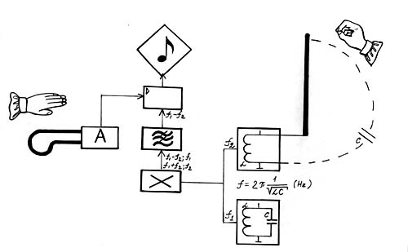
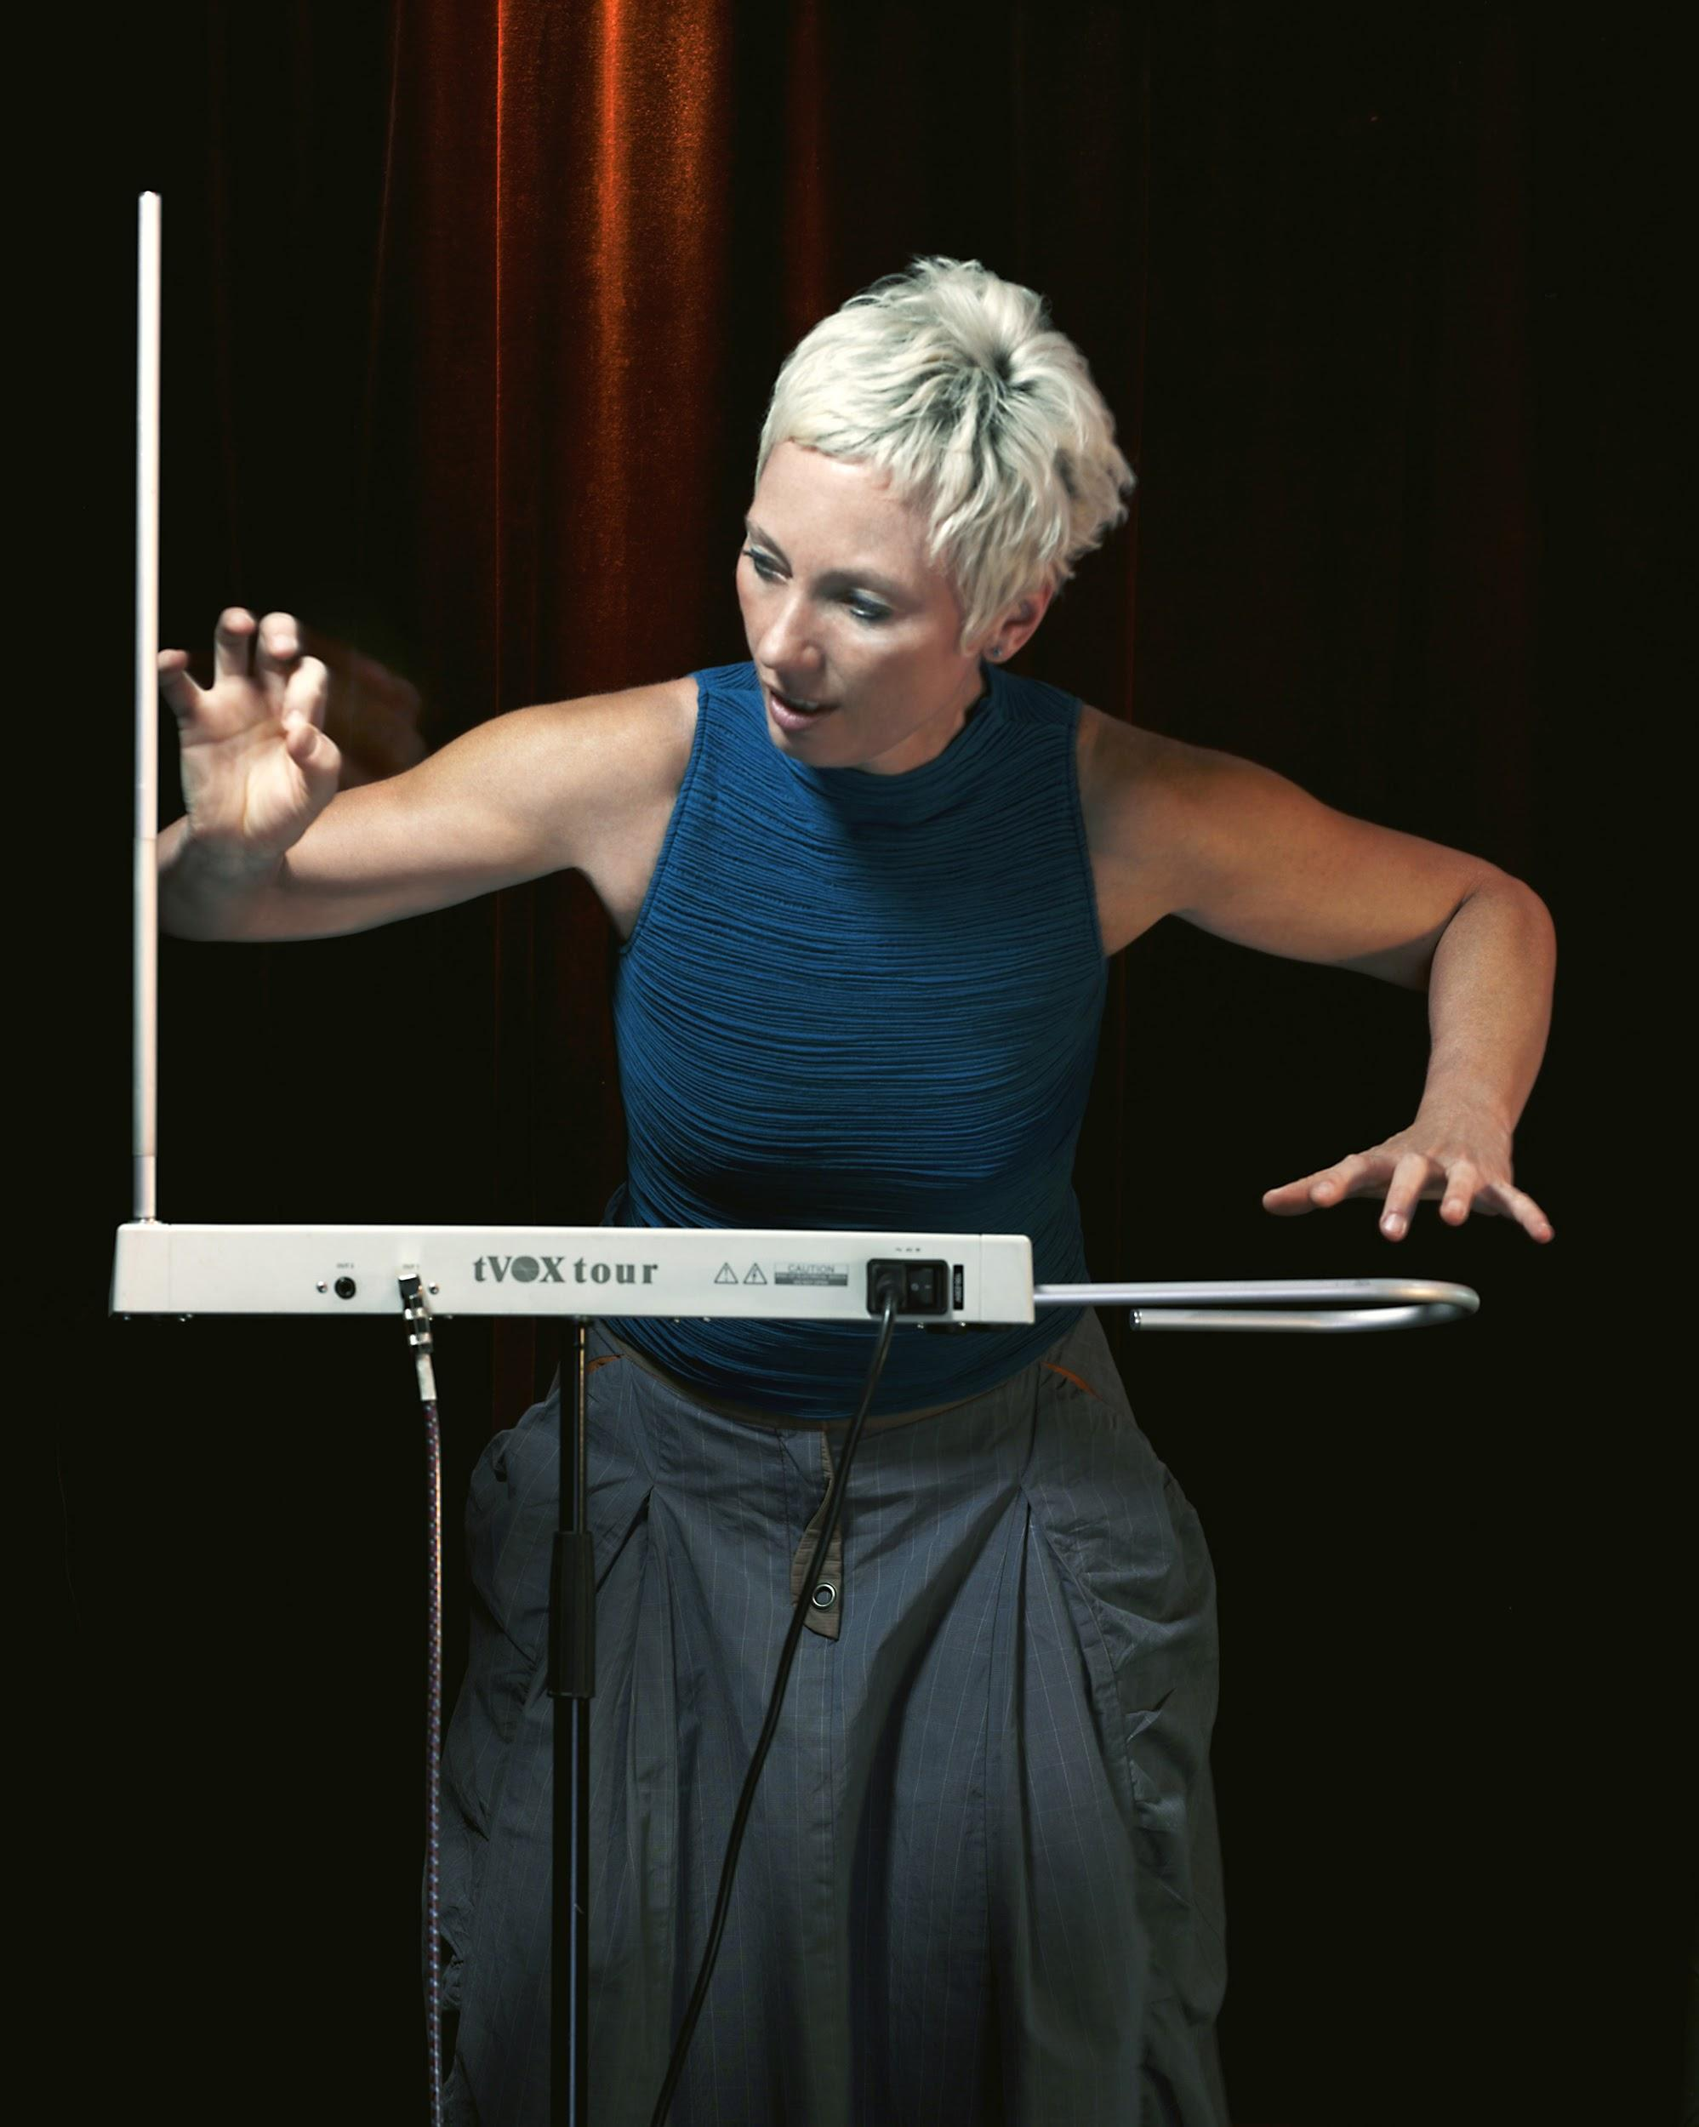

Slide 3
Rare Interview with Dr. Theremin
Interview conducted June 16, 1989 in Bourges, France
Theremin said his inspiration came from an orchestra conductor. “I conceived on an instrument that would created sound without using any mechanical energy, like the conductor of an orchestra. The orchestra plays mechanically, using mechanical energy; the conductor just moves his hands, and his movements have an effect on the music artistry [of the orchestra].”
When asked why he made the Theremin; “I was not satisfied with the mechanical instruments in existence, of which there were many…I was interested in making a different kind of instrument.”

Slide 4
Clara Rockmore

Slide 5
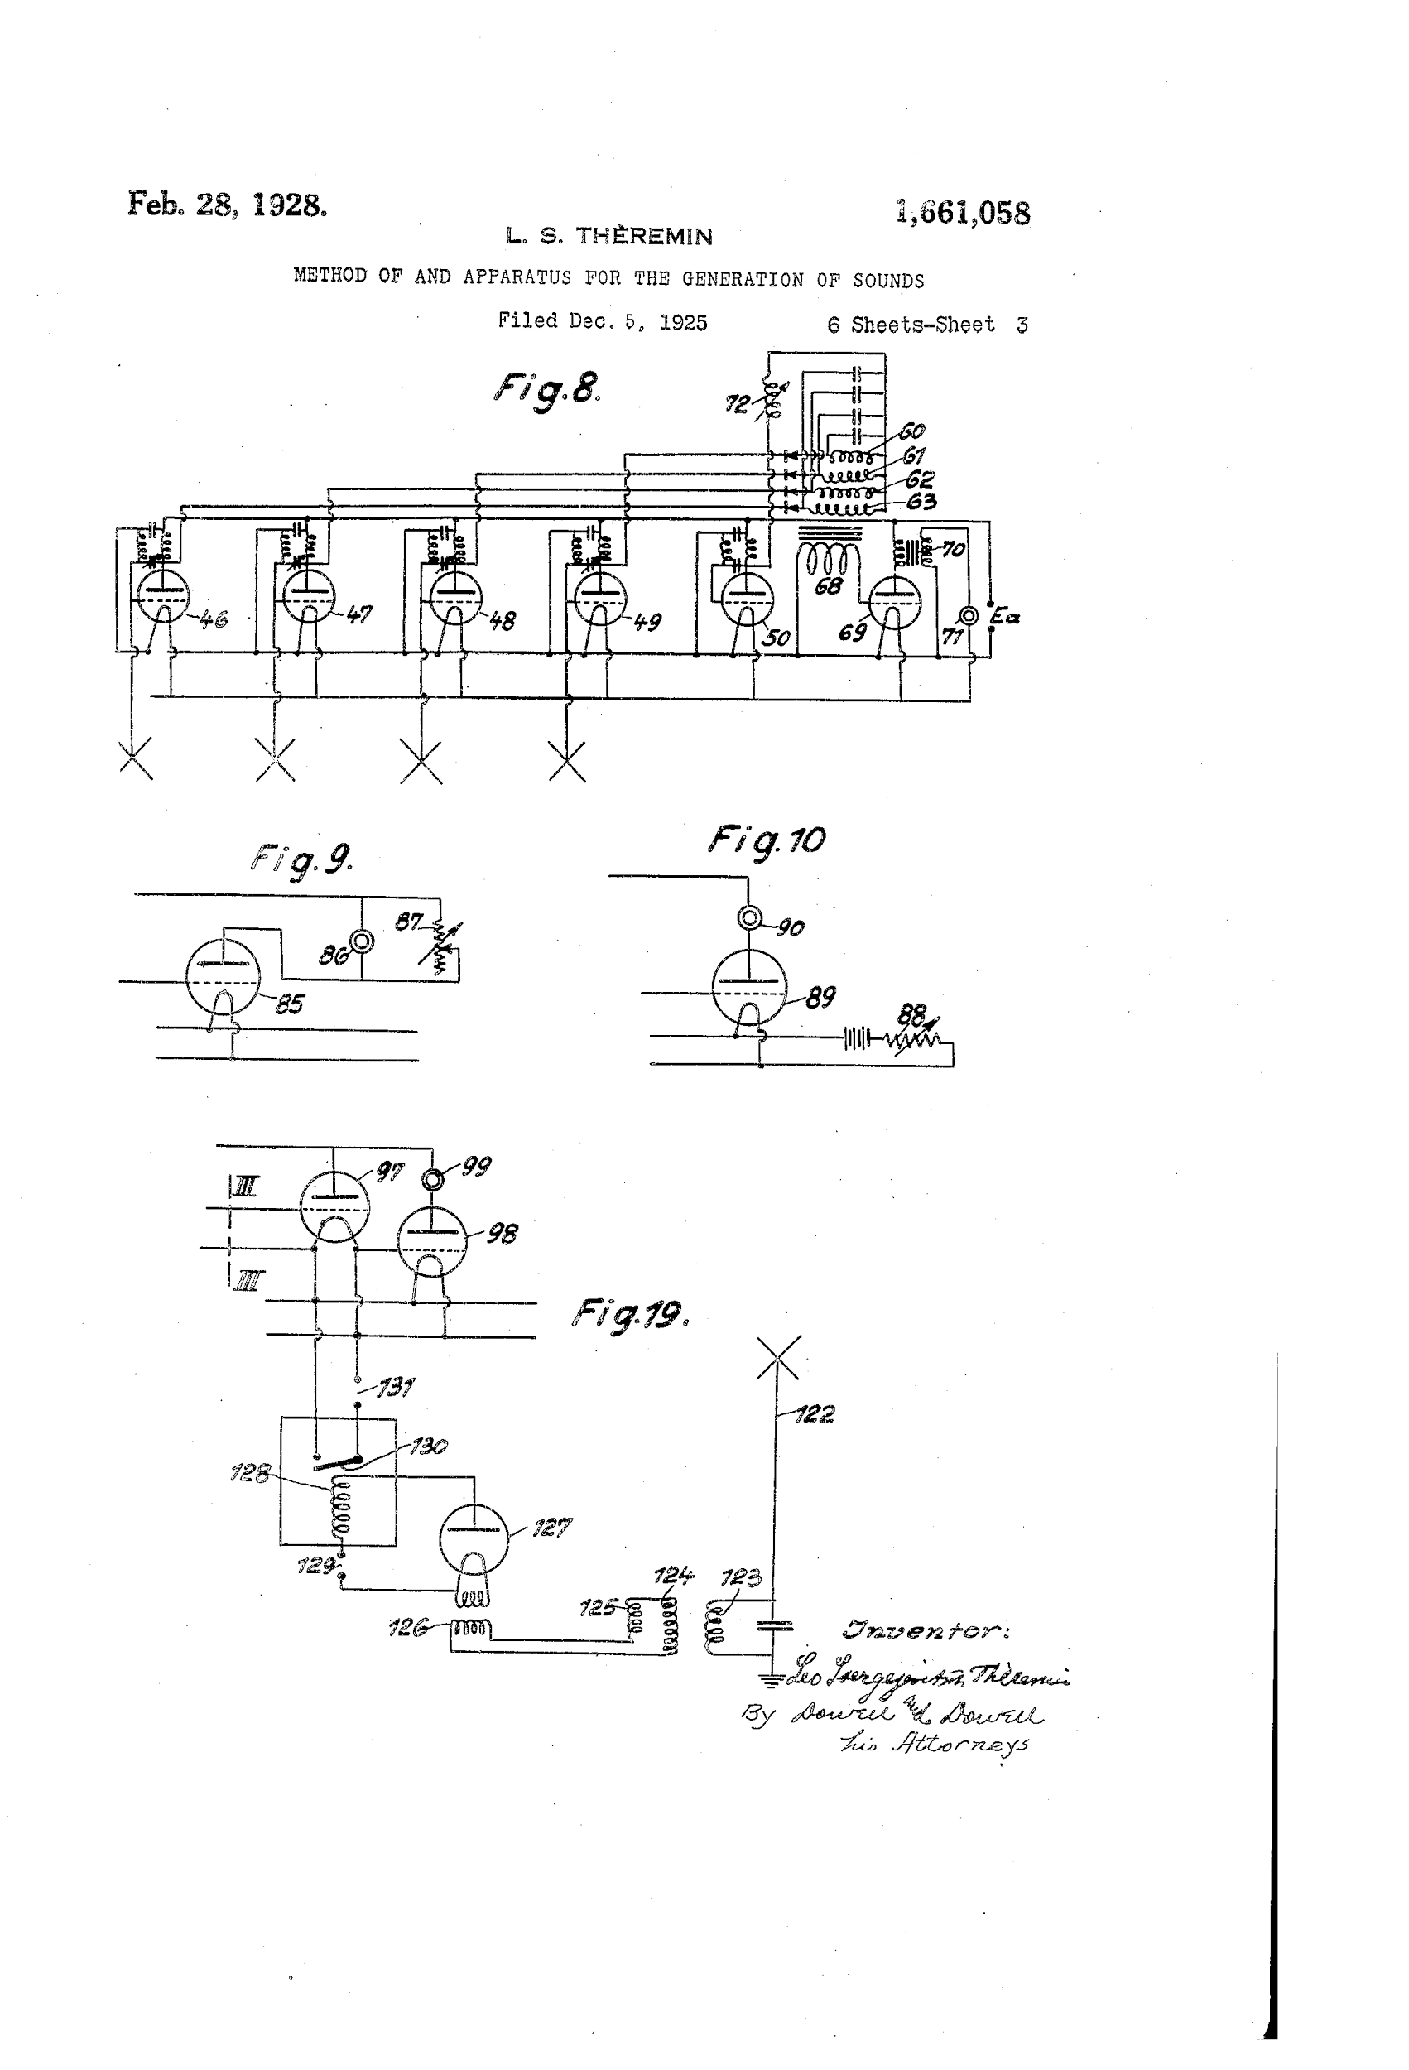
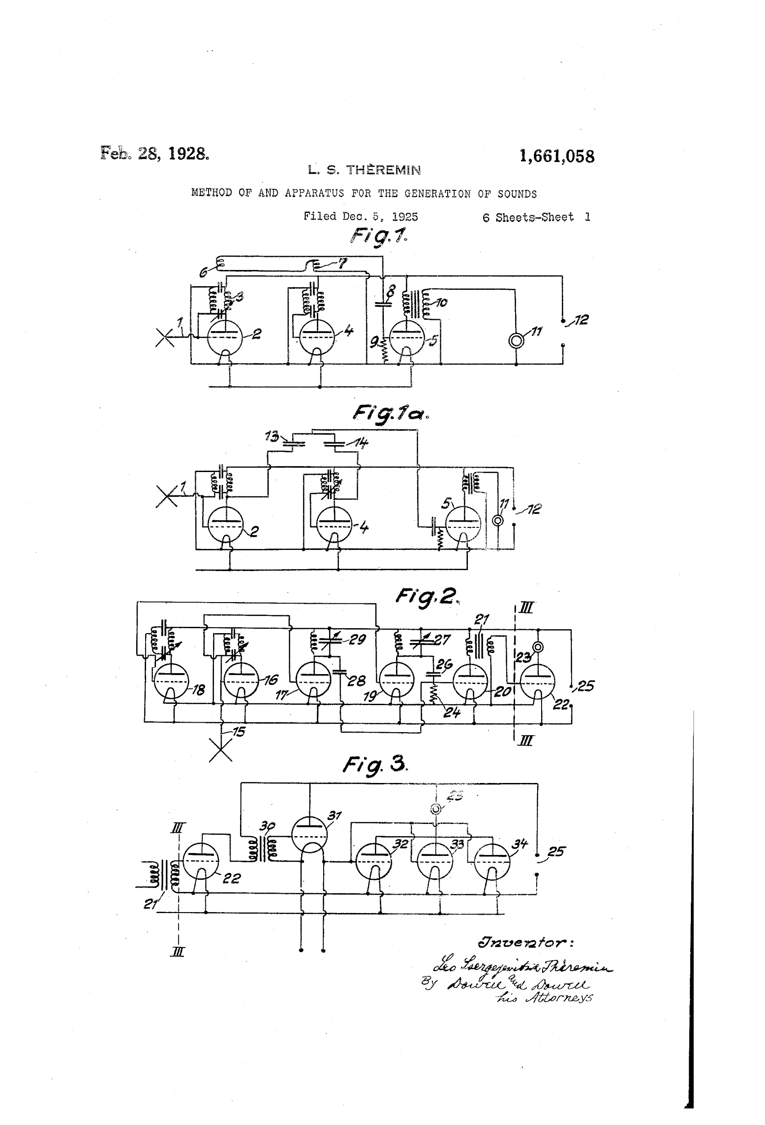
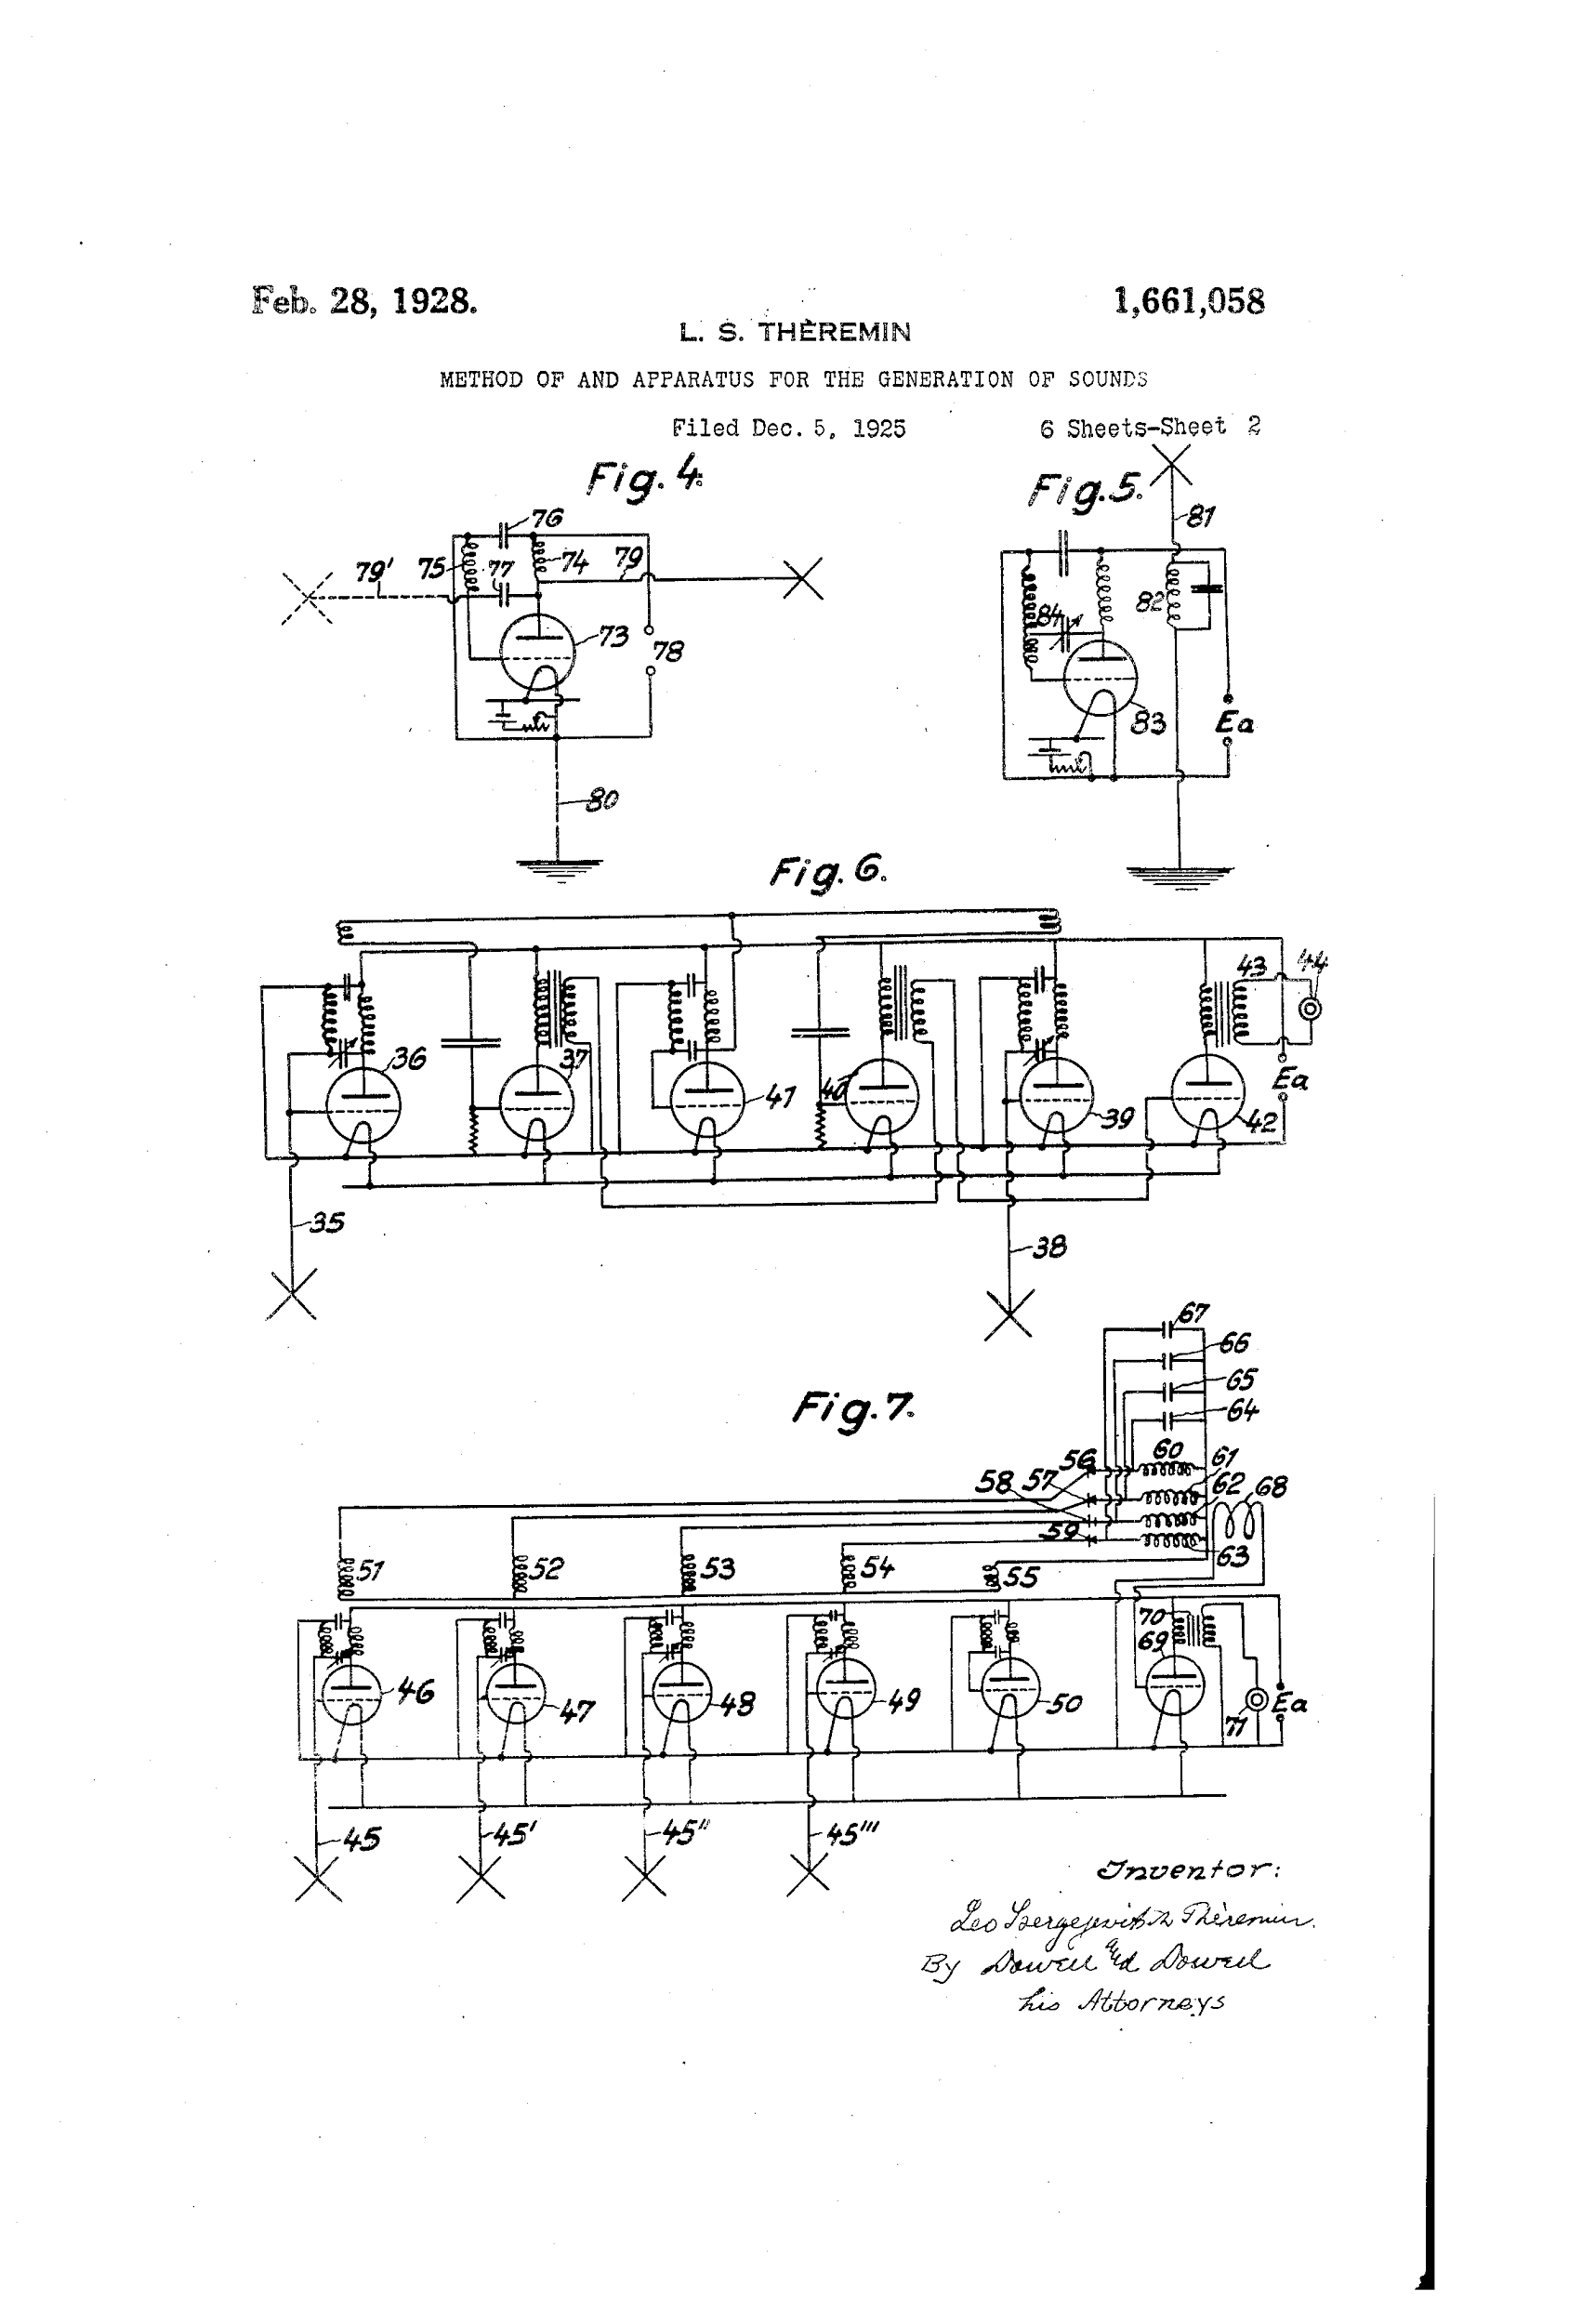
Original Theremin Patent

Slide 6
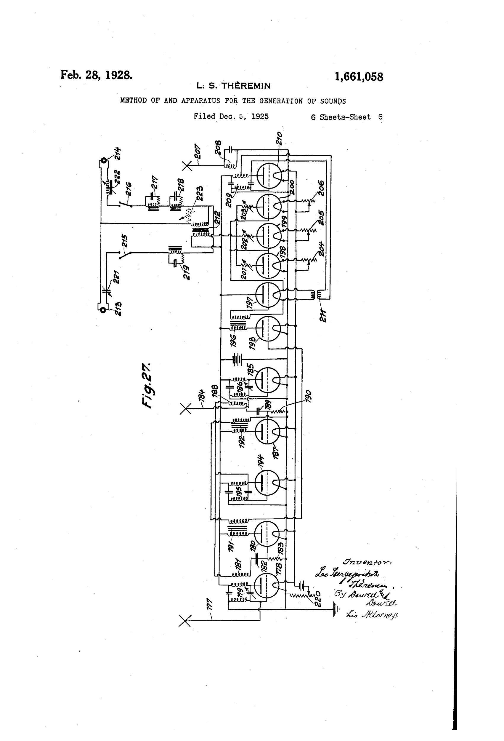
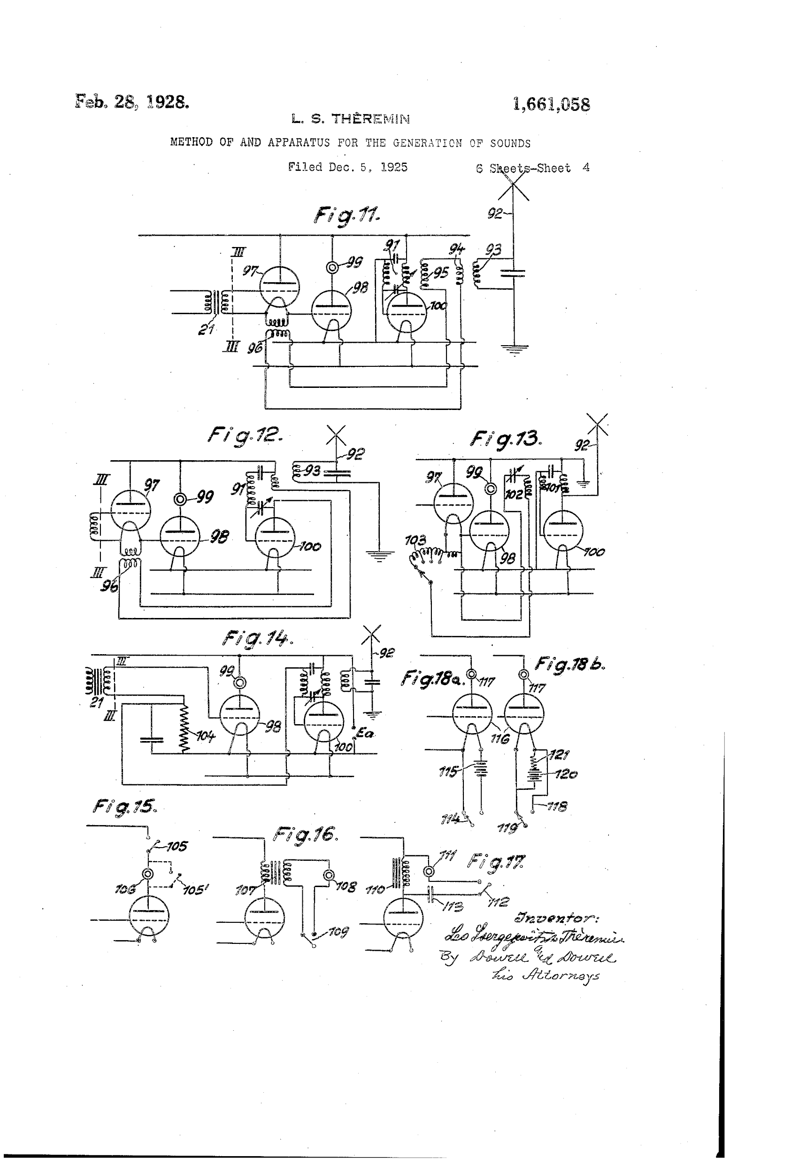
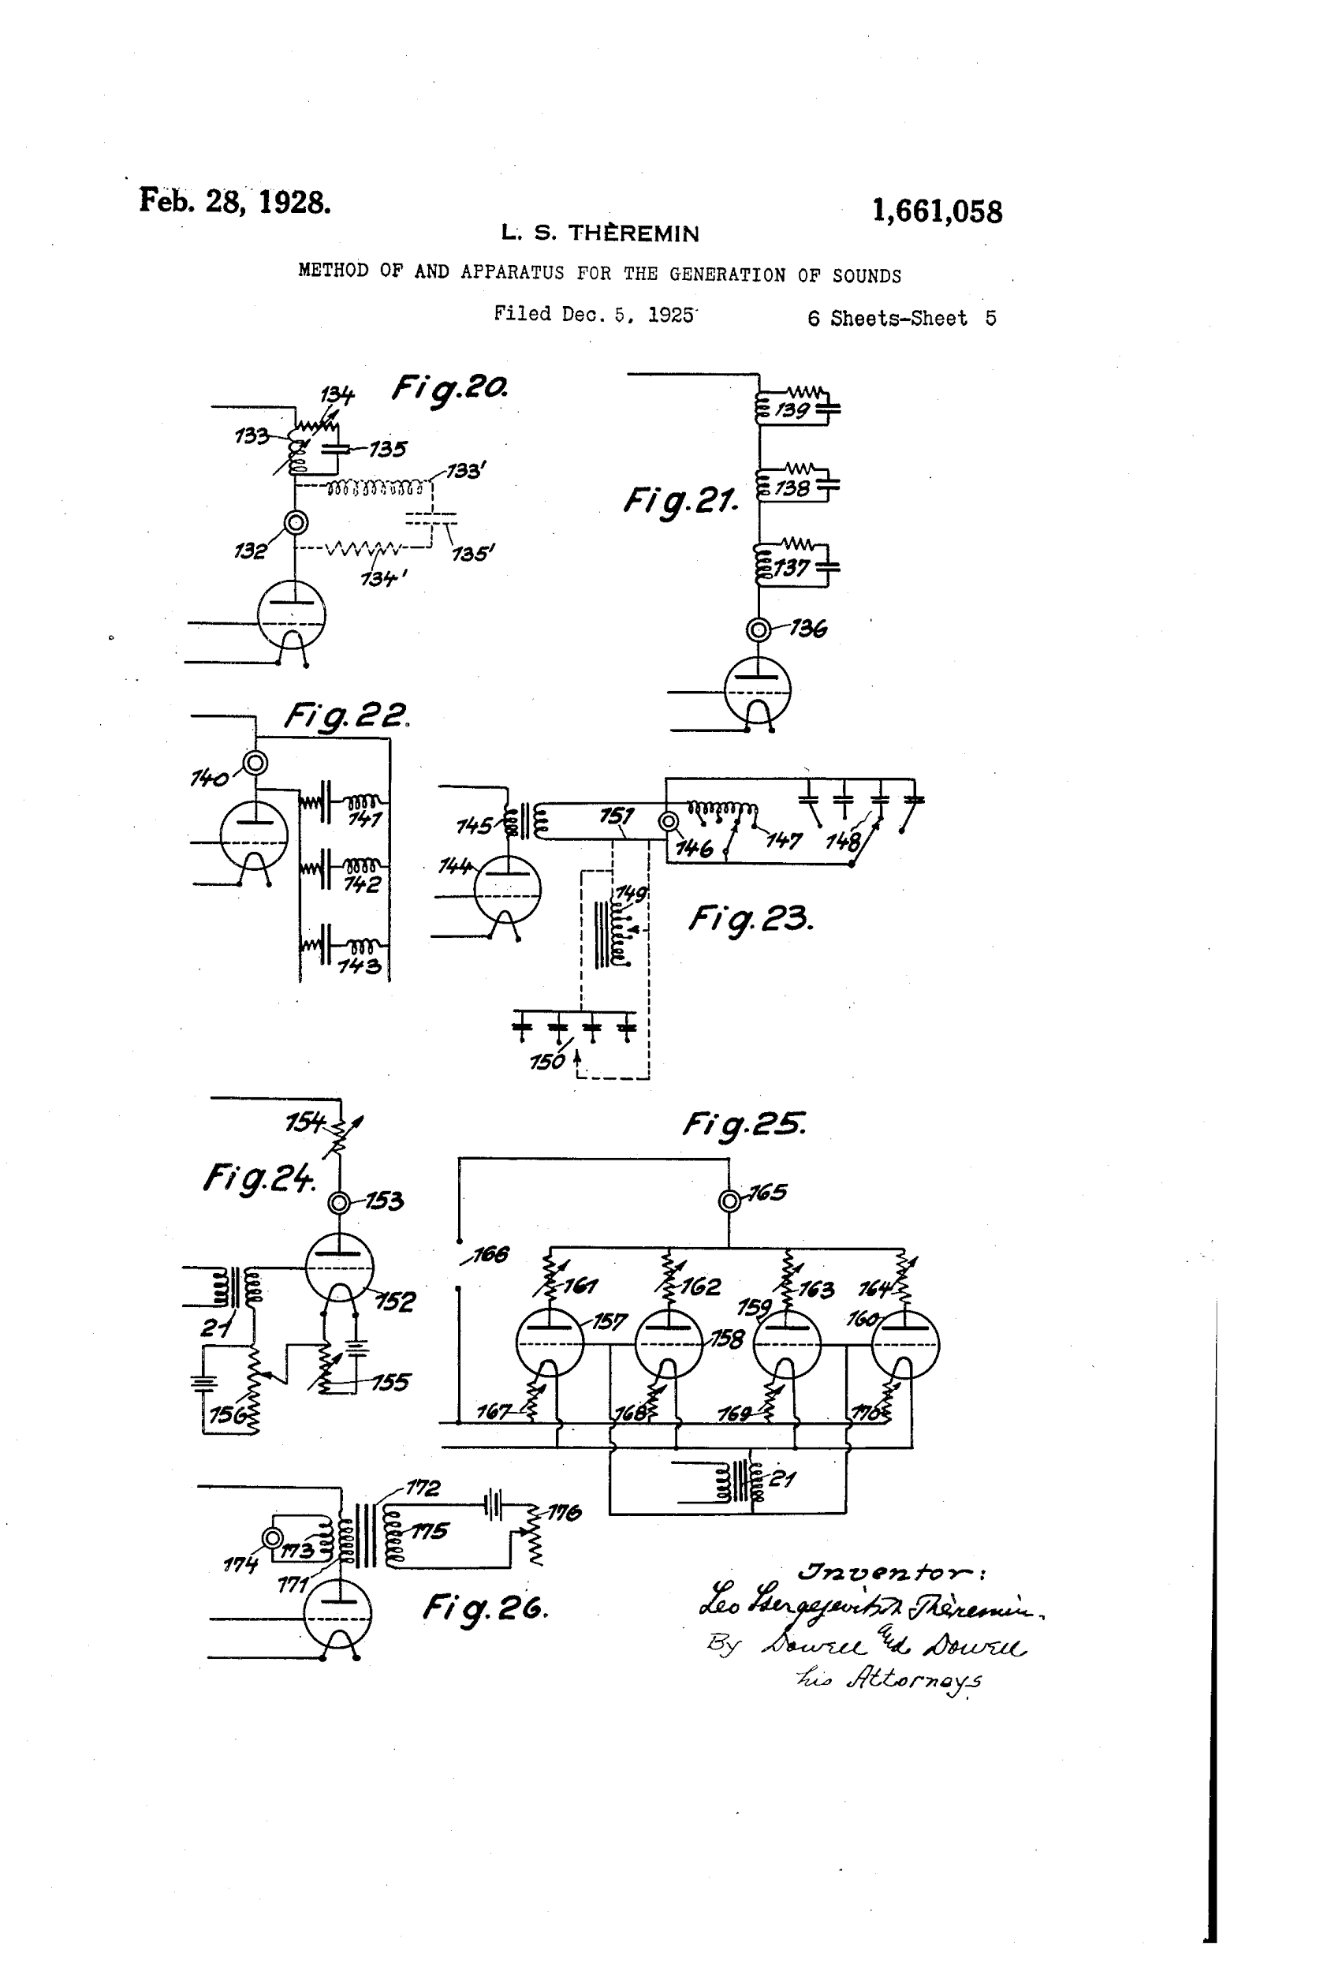
Original Theremin Patent

Slide 7
Links:
https://www.youtube.com/watch?v=pSzTPGlNa5U
http://patentimages.storage.googleapis.com/pages/US1661058-0.png
http://patentimages.storage.googleapis.com/pages/US1661058-1.png
http://patentimages.storage.googleapis.com/pages/US1661058-2.png
http://patentimages.storage.googleapis.com/pages/US1661058-3.png
http://patentimages.storage.googleapis.com/pages/US1661058-4.png
http://patentimages.storage.googleapis.com/pages/US1661058-5.png
http://theremin.ca/mattis/mattis.html

