Slide 1
Soundwalk: A Journey Through Sound
Dan Nissim & Sarah Pallito

Slide 2
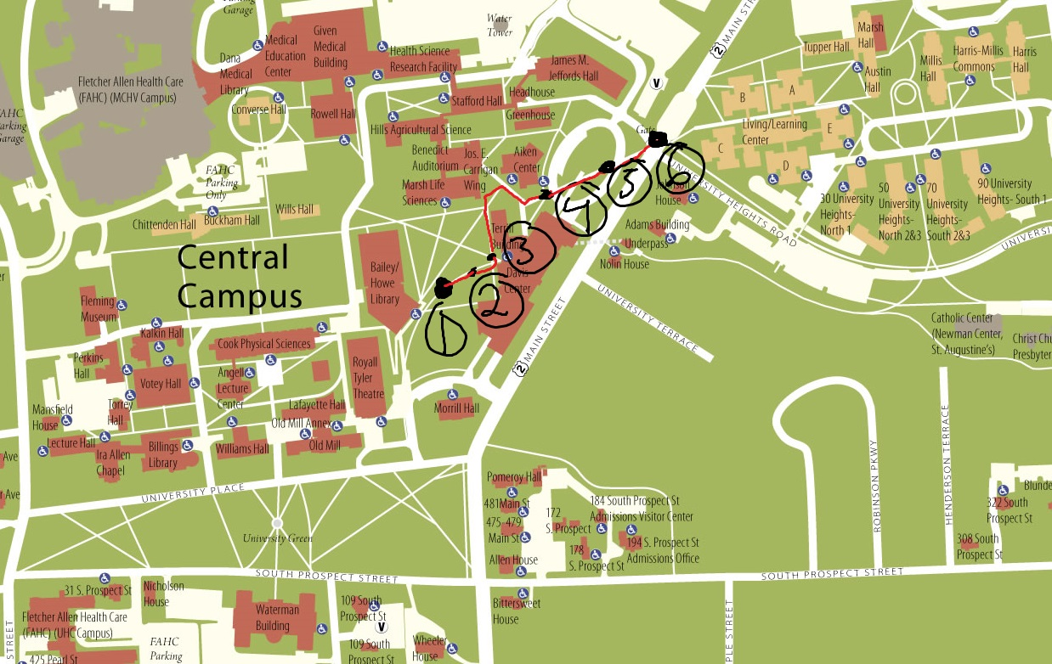
Key
Sitting Location
Fraternity Table (Music)
Conversation
Freight Plane
Start Hearing Road Traffic
Chaos

Slide 3
Some Observations
Main sounds
Foot falls (different types of shoes)
Laughter → Keynote sound
Bits of conversations
Rises in volume made conversations more evident
Wind was a major drone
Sitting experience was very peaceful

Slide 4
Clip
From Davis center loop to Main street

Slide 5
Thanks!

