Slide 1
UDL@UVM
Supporting Faculty To Teach All Students
Using A UDL Consulting Team Model
Center on Disability and Community Inclusion
Funded by: U.S. Department of Education
Office of Post-Secondary Education
Notes:
SE

Slide 2
This Workshop
To describe a collaborative consultation model to assist university faculty to incorporate
UDL principles and practices into coursework to benefit ALL students.
Notes:
SE

Slide 3
The Grant
US Dept. of Education, Office of Post-Secondary Education
Currently in year 2 of a 3 year grant period
Staff – 11 Personnel
One full time Administrative Coordinator
Everyone else part time, including
Co-Principal Investigators
One Faculty member (recently “retired”)
Doctoral Candidate (Ed Leadership)
Post BA Graduate
Design Team Members**
Center for Teaching and Learning
Academic Support Services
Notes:
SE

Slide 4
You
What is your role?
What do you know about the topic?
What do you want to leave this session knowing?
On the following graphic, place yourself in the
quadrant that best describes the dynamic of input
in your teaching or consultation relationships .
Notes:
SE
Charlie will record on white board key ideas.
Consulting is term we here a lot but few stop to think about a process of consulting or how it might best be accomplish. Some think of the consultant as the main source of ideas for change bringing expert knowledge to a situation or problem. Others might think about wanted to be involved as a consultee in contributing to the solutions.

Slide 5
Consultant
Contribution
High
Q2
Q1
Consultee
Contribution
Low
High
Q3
Q4
Low
Notes:
CR
Share responses

Slide 6
What We Want To Share…
A Process that falls in Q1
How to support faculty to use principles of UDL in their teaching.
Notes:
CR

Slide 7
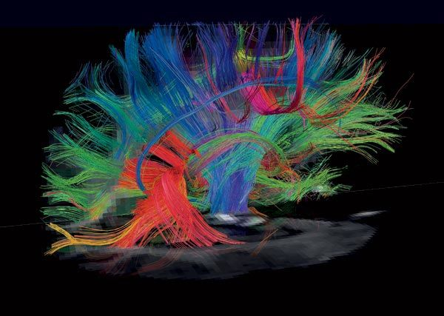
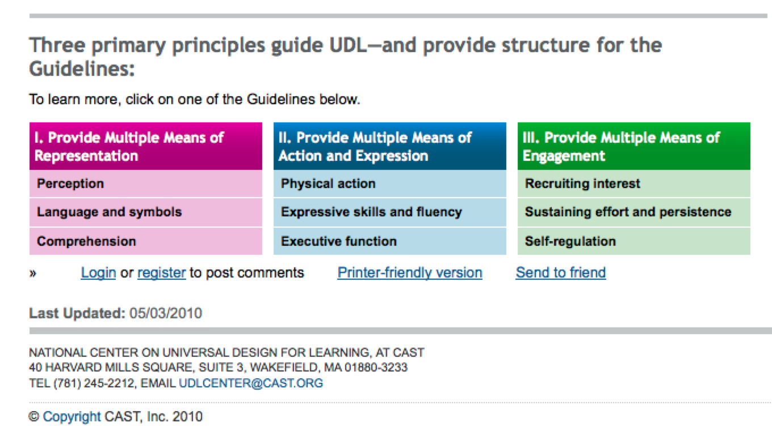
UDL@UVM
Neuroscience of Learning
CAST Educator Guidelines
Collaborative Teamwork
∞
Notes:
CR

Slide 8
Learning is constructed on neural pathways. Learning deepens when you excite activity across multiple networks. New neural connections grow. Learning is actual physical change. Every person’s networks differ.
Notes:
CR

Slide 9
CAST UDL Framework
Neural Network | UDL Principle | Focus For Design Work
Recognition | Multiple Means of Representation | Presentation of Material To Be Learned
Strategic | Multiple Means of Expression | Students’ Opportunity to Show What They Are Learning
Affective | Multiple Means of Engagement | Interactions of Students With Each Other And With Course Content
Notes:
HBP

Slide 10
Collaborative Consultation Model
Purpose is to provide technical assistance/consultation to individual faculty to implement selected UDL practices in their teaching and courses
Collaborative approach
Based on research of effective group process and productivity
Rationale:
No one discipline has the answers
Multiple perspectives and expertise
Fosters creativity of unique solutions best suited
Effective model of “wrap-around’ support
Notes:
HBP

Slide 11
UDL@UVM Team
Faculty
Charlie
Larry
Susan
Graduate students
Puja
Holly
Technology
Nick
Zach
Notes:
HBP

Slide 12
Notes:
HBP

Slide 13
Faculty Referral and Intake
UDL Reflection and Recommendation
Action Plan Development,
Implementation and Evaluation
Follow-Up

Slide 14
Results/Outcomes To Date
UDL Principles
Multiple Means of Representation
Multiple Means of Expression
Multiple Means of Engagement
Notes:
SE

Slide 15
Summary Data
11 Faculty Consultations
Range of departments and/or disciplines represented (English, Psychology, Education, Engineering, Health Sciences, Nursing, CDAE, Business)
Ranging from 1 to 15 consultation contacts per faculty member
Seven ongoing now
Each served by min. 3 member team, most more than 3

Slide 16
Results/Outcomes To Date
UDL Principles Emerging
Multiple Means of Representation
Graphics, visuals, video, concept maps, posted notes, audio files of classes and posting, iPod recordings in class
Multiple Means of Expression
Incorporation of movement, small group activities, large group participation, graphic organizers, clickers, OPTIONS for assignments
Multiple Means of Engagement
Online forums, small groups, helping design rubrics or assessment criteria, wikis, threaded discussions
Notes:
SE

Slide 17
What’s It Look Like ?
Self Assessment and Interview | Faculty Consultee
Individual Assessment | UDL Consulting Team Member
Principle Assessment | UDL Consulting Team
Team Recommendations | UDL Consulting Team
Action Plan Mtg. Agenda | UDL Consulting Team Leader
Action Plan | Consulting Team
Notes:
CR

Slide 18
Individual Assessment

Slide 19
Principle Assessment

Slide 20
Team Recommendations

Slide 21
Action Plan Meeting Agenda

Slide 22
Action Plan

Slide 23
You Think, Pair, Share, Report
In what ways might you apply the UDL principles in your work ?
Representation
Expression
Engagement
Notes:
SE

Slide 24
Collateral Findings
Coveted Conversations About Teaching
Trust In The Process
A Reciprocal Interplay of Expert Knowledge (Consultee) and Strategic Knowledge (UDL Team) on behalf of UDL
The Consulting Model Is Quite Rational But The Outcome Paths Are Not Straight Lines
There Are Benefits and Risks for the Consultee
Notes:
CR+

Slide 25
You
Revisit your location on the Consultation Graphic
Where would you like to be ?
How might you intentionally shift quadrants ?
Open discussion: did we work with your intended session outcomes ?
Notes:
CR+

Slide 26
Workshop 315
A Peek Into The Consultation Process:
Evolving An English Course
Jost Room
What has evolved in one faculty consultation
for a course in American Literature.
An Example of Consultation At The Intensive Level.
Notes:
CR+

Slide 27
Wrap Up and Evaluation
Notes:
CR+

