Slide 1
Tools to Support Instruction
With representation, expression & engagement in mind…

Slide 2
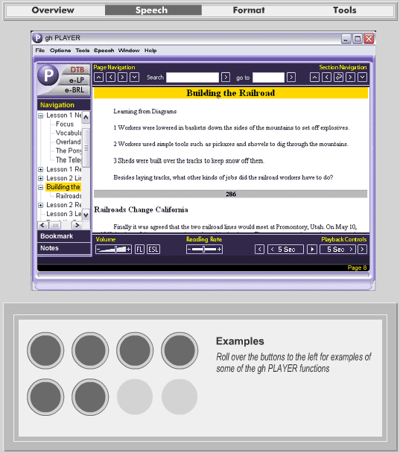
An early vision
Gh Demo - 2002

Slide 3
The NIMAS Initiative
Build once; Transform many

Slide 4
UDL Editions redux
Call of the Wild

Slide 5
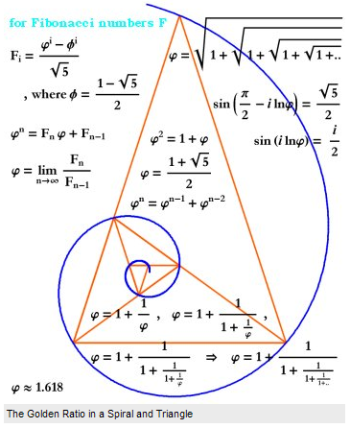
Building Books
The Golden Ratio

Slide 6
The problem of math
Write this down: “1 divided by X plus 1”

Slide 7
The problem of math
MathML & MathSpeak

Slide 8
Supported Reading Software
How to Choose?

Slide 9
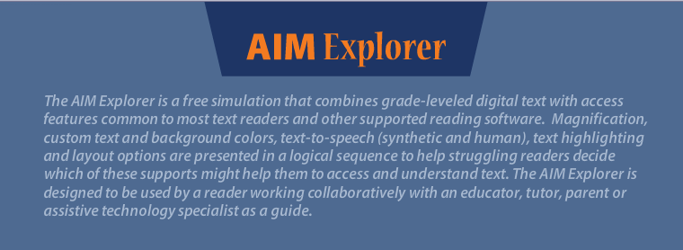
Supported Reading Software
How to Choose?
AIM Explorer http://aim.cast.org/experience/training/explorer

Slide 10
Supported Reading Software
How to Choose?
AIM Product Features Chart http://aim.cast.org/experience/training/explorer/aim_products_chart
AIM Product Tutorials
http://aim.cast.org/experience/training/tutorials

Slide 11
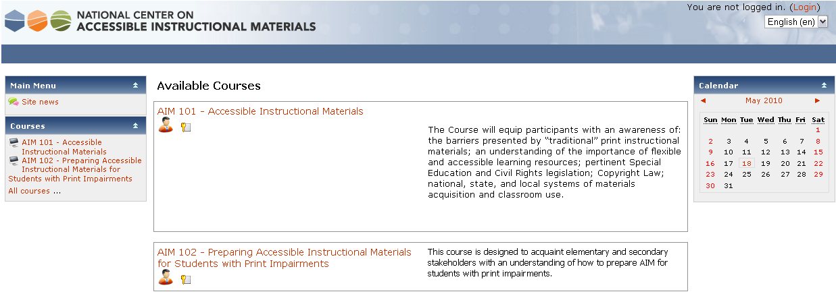
AIM Online Modules
http://teachweb.cast.org/moodle/

Slide 12
UDL Online Modules
http://udlonline.cast.org/home

Slide 13
T560 Note-Making
David’s Class

