Slide 1
Reaching Every Student
UDL in Post-Secondary Practice
Skip Stahl

Slide 2
UDL Guidelines Checklist
Full Guidelines at http://www.udlcenter.org/aboutudl/udlguidelines

Slide 3
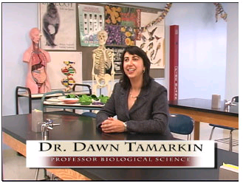
UDL in Biology 101
http://www.classaccommodation.org/UDL%20Project/biology.htm

Slide 4
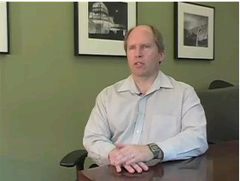
UDL in Information Systems
Session #1: Overview: http://pachyderm.cdl.edu/elixr-stories/udl-information-systems/

Slide 5
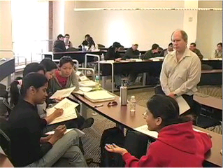
UDL in Information Systems
Session #2: Small Group Discussions: http://pachyderm.cdl.edu/elixr-stories/udl-information-systems/

Slide 6
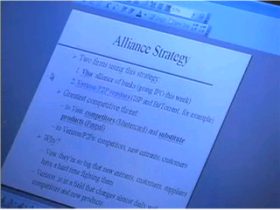
UDL in Information Systems
Session #2: Guided Notes: http://pachyderm.cdl.edu/elixr-stories/udl-information-systems/

Slide 7
UDL in Teaching English
Arlene Rodriquez Case Study Video http://ctfd.sfsu.edu/universal-design-for-learning-online-training-module.htm

