Slide 1
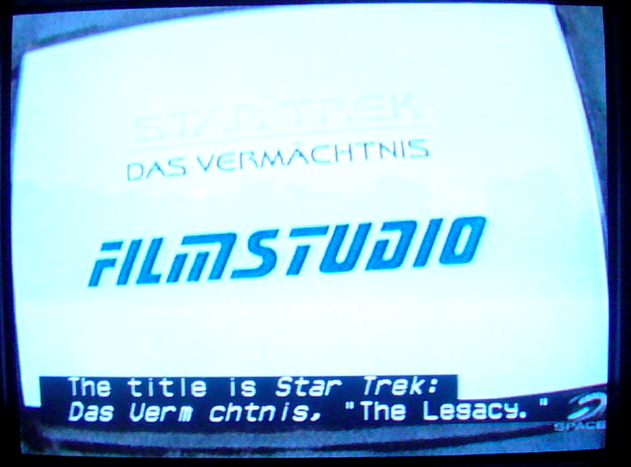
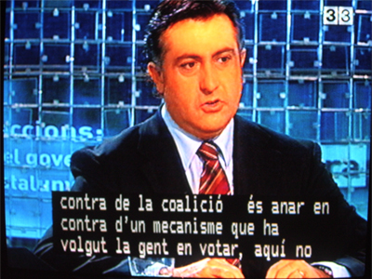
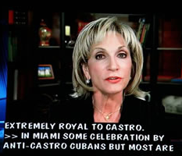
Captioning: Not Just for Deaf and Hard of Hearing Students
Elaine Morse and Nick Ogrizovich
UVM UDL Conference
May 17, 2010
Notes:
Title accurate for presentation? Not too many slides about benefits for non deaf

Slide 2
Types of Captioning and Subtitles
Types of Captioning
Traditional captioning
Subtitles for Deaf and Hard of Hearing
Open captioning vs. closed captioning
Decoder needed for closed captions except online

Slide 3
Why Use Captioning?
Captioning provides access to the spoken language and the sound effects of a film.
It is impossible to watch the interpreter/transcriber and the film at the same time.
Films are harder to follow than a lecture
Captions can be used by EVERYONE
Coda Brothers
Coda Brothers Part 2
Why are sound effects important?
The Brady Bunch
Notes:
There are multiple speakers
The camera is not always focused on the speaker
There is background noise or music playing at the same time as the speaker
There are quick changes in scenery, time and location
English Language Learners understand better when they can read and hear
Seeing AND hearing increases comprehension, especially with unfamiliar concepts and vocabulary
Noise, noise, noise

Slide 4
Captions Benefit Everyone!
Students for whom English is a second language
Individuals with learning disabilities
Students who do not have a disability
Noisy classrooms
Large Audiences
Notes:
. If any information is missed aurally, the student can obtain this information from the captions.

Slide 5
Captions vs. Subtitles
Captions | Subtitles
Can usually be turned on or off – closed | Can’t always be turned off - open
Includes sound effects, music lyrics | does not always include sound effects or lyrics
Includes all spoken dialogue | May only appear when speaker is not speaking English
Used for most VHS, DVDs feature length and some educational films, online media | Used for foreign language films, DVDs and online media
Notes:
Captions will show up ONLY if theres a decoder on the system. Using a projector, your only choice is subtitles, unless you have a decoder box inline with the projector

Slide 6
What if I can only find Subtitles?
In the real world, captions and subtitles are used interchangeably, especially with online videos
When looking for accessible media, look for BOTH captions and subtitles
Most feature length films, TV productions and other hard media will be captioned
Most online videos will be subtitled

Slide 7
How do I know if my media is already captioned?
Look for on the back
Check the DVD menu under setup or languages
Look online
Ask the librarian
Ask your Disability Services Office
Call the production company to see if they have a captioned version
SDH

Slide 8
How do I find Captioned Media Online?
Google
I Have A Dream
Youtube - subtitled or transcribed audio
YouTube Search
Try to use Captions and not English (transcribed)
Steve Jobs
Ted Talks
How the Brain Learns to See
PBS.com
American Experience
See our website
Websites with Captioning/Subtitles

Slide 9
The BAD news about captioning feature-length materials
It’s expensive, especially if done post-production
It can take a week to several weeks to caption a long film
Most independent, religious and educational media is not captioned
Most libraries require copyright holder permission to get material captioned
Complicated, difficult process at times, especially for older films
Notes:
* Sometimes the copyrightholder is deceased, or company no longer exists

Slide 10
The GOOD news about captioning
Online videos are usually quick, cheap, and easy to caption
Most mainstream or popular DVDs have captions
Most Universities have a budget to cover the cost of captioning
Captioned materials benefit everyone in an audience
Subtitling is available on more and more online videos
You can caption your own media

Slide 11
Recommendations
Look online to see if a version exists that is already captioned or subtitled
Call the production company and ask for a captioned version
If you send a film to a captioner, ask for OPEN captions
Choose newer media over older films, DVDs over VHS
Check out www.uvm.edu/~captions

Slide 12
Caption/subtitle media yourself
Two basic methods:
If under ten minutes, use google (youtube)
If over 10 minutes, you have to manually caption
This assumes the media is digital
Analog media would have to be ‘sent out’ or converted to digital
If media is on DVD, you can ‘rip’ it using a free program called handbrake

Slide 13
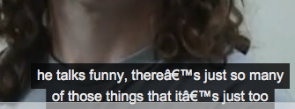
Step by Step for adding subtitles to video (make your own transcript)
Get a transcript first:
Work study students can type these up
Do not need time-code, etc
Straight, unformatted text (not MS Word!)
Use text edit on macs or notepad in PC’s
Gibberish will result if there’s unrecognized ‘junk’ in a text file:

Slide 14
Manual Captions, Con’t
Separate the text into short 4 to 6 word sentences, two lines, one space between:
On behalf of the entire community of The University
of Vermont, I am delighted to welcome all of the
participants in Universal Learning by Design.

Slide 15
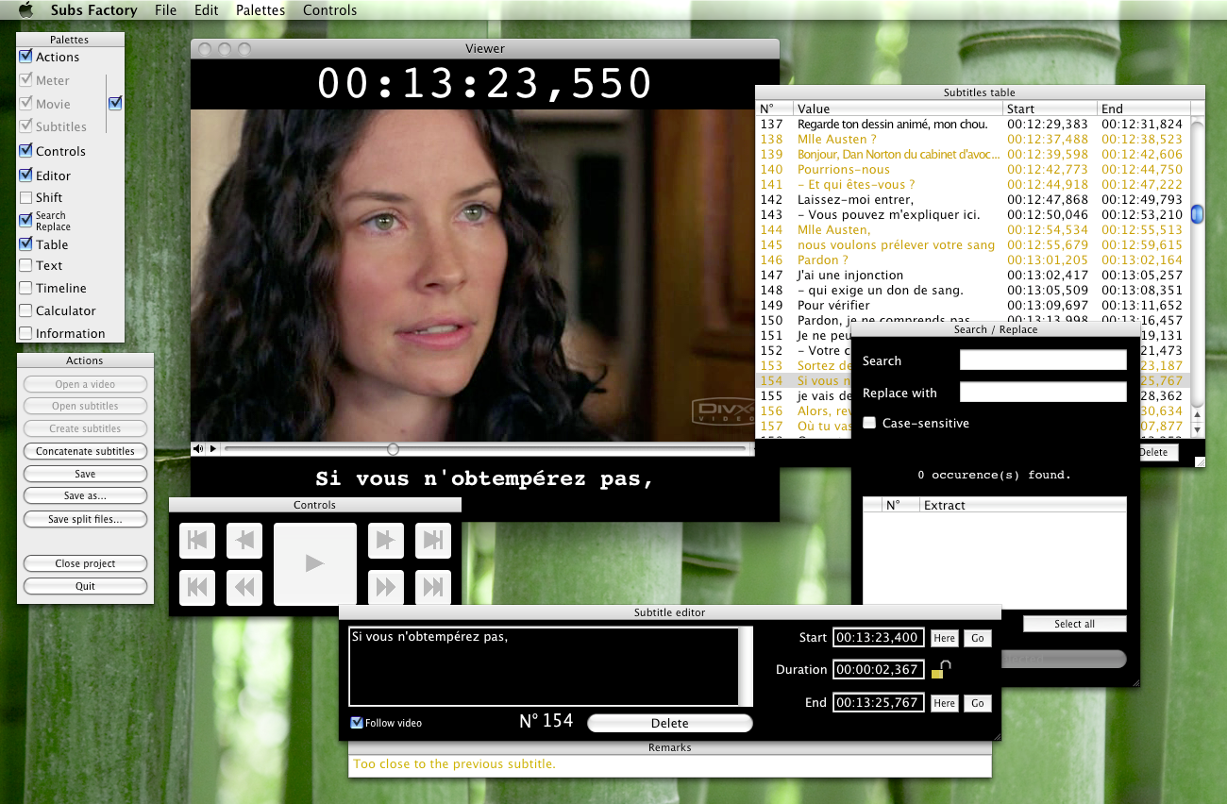
Manual Captions, Con’t
After obtaining a good transcript, it will be easier to manually add time codes
Software programs easily do this
Sub Factory (free, for mac OSX)
The program generates a timecode file
Most subtitling programs work similar →

Slide 16
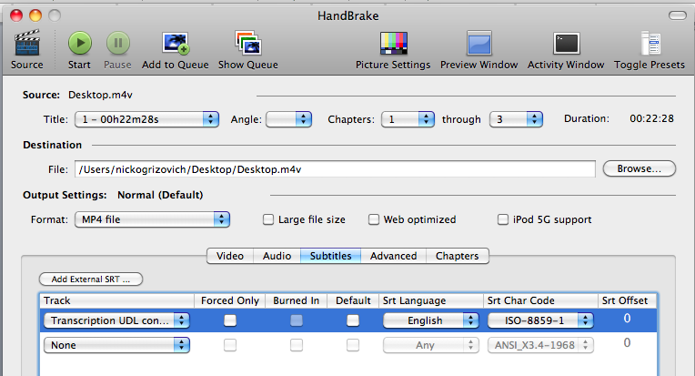
Manual Subtitles, Con’t
Save the finished file (should be .srt)
Have to add the .srt file to the video-
Easiest way is to rip a file using handbrake and ‘burn in’ subtitles (makes a new file)

Slide 17
Looks like this when done

Slide 18
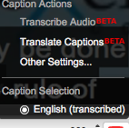
Adding Captions using google’s voice recognition (10 min limit)
After uploading video, go to the video’s page in your video list
Click on ‘request machine translation”
This can take a few days
After process is finished, that video will then offer users the ability to turn on/off captions
This little window becomes available once transcription is complete →

Slide 19
Upload video

Slide 20
Go to ‘my videos’, click on captions

Slide 21
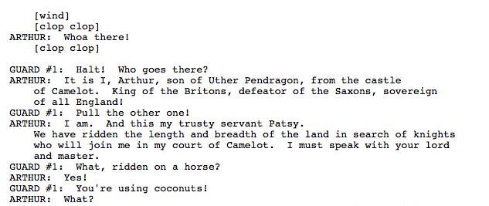
Add subtitle file
Text file example

Slide 22
Auto-sync process (or, go get a coffee)
Depending on the length of your video and internet speeds, this part can be as short as 5 minutes or as long as an hour.
No user input needed, so go find something else to do!
Once this process is complete, the video will have an option available:

Slide 23
Real Time Subtitle Example
http://www.youtube.com/watch?v=MIeD0uRWeYA&feature=related
This one works almost flawlessly!
http://www.youtube.com/watch?v=PQ7y9Wc8nxA&feature=player_embedded
This one fails cosmically…!
What are key differences between the two files that might contribute to this?

Slide 24
Subtitle tricks
Often a video’s captions will work better on the native site, rather than embedded in another site:
Youtube videos embedded sometimes lose the captions- but if you click on the video and open in youtube, they will usually work
TED.com lectures are usually subtitled in 20 languages, but subtitles ONLY work on TED.com, and will not work if streamed to a site using embedded video.

Slide 25
