Slide 1
Student Voice: The Nuts and Bolts and the Latest Research
Dana Mitra
Professor of Education
Penn State University
dana@psu.edu
@docdana

Slide 3
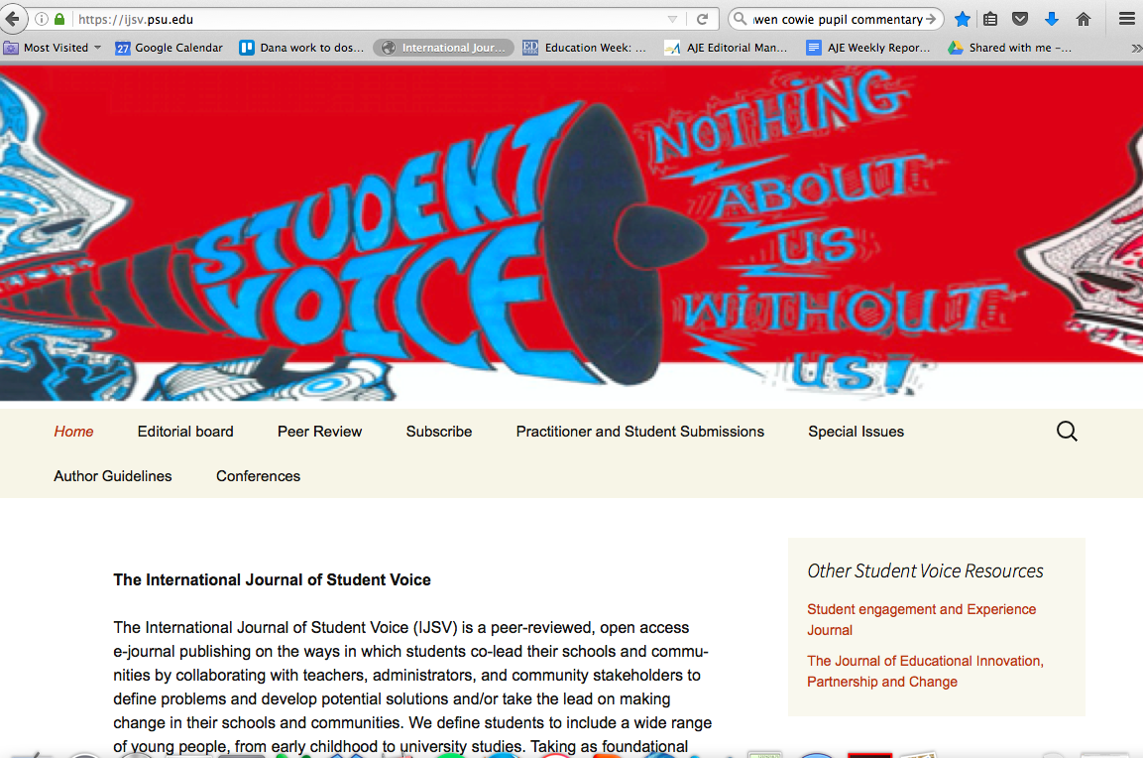

Slide 10
Samantha Holquist

Slide 11
Samantha Holquist

