Slide 1
The Roots and Branches of the International Student Voice Seminars
Alison Cook-Sather
Mary Katharine Woodworth Professor of Education, Bryn Mawr College
Director, Teaching and Learning Institute, Bryn Mawr and Haverford Colleges

Slide 2
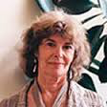
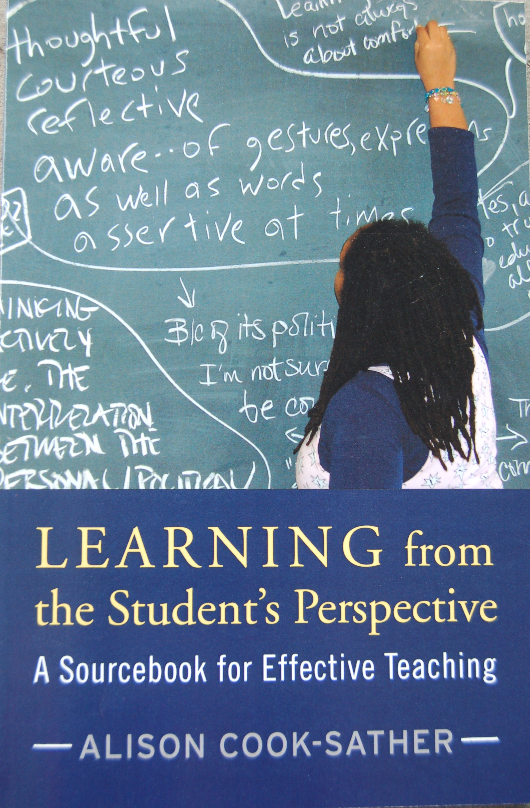
Re(in)forming the Conversations: Student Position, Power, and Voice in Teacher Education. Radical Teacher , 2002.
Sound, Presence, and Power: Exploring “Student Voice” in Educational Research and Reform.
Curriculum Inquiry, 2003.

Slide 7
To nurture multiple branchings off from the roots of Jean Rudduck’s pioneering efforts and accomplishments
To create a space within which no one has to explain “student voice” or “student-teacher partnership”
To provide continuity for students, scholars, practitioners, and policy makers working to be partners in teaching and learning
To support the making of connections across contexts and levels that lead to generative research and practice collaborations and projects

Slide 8
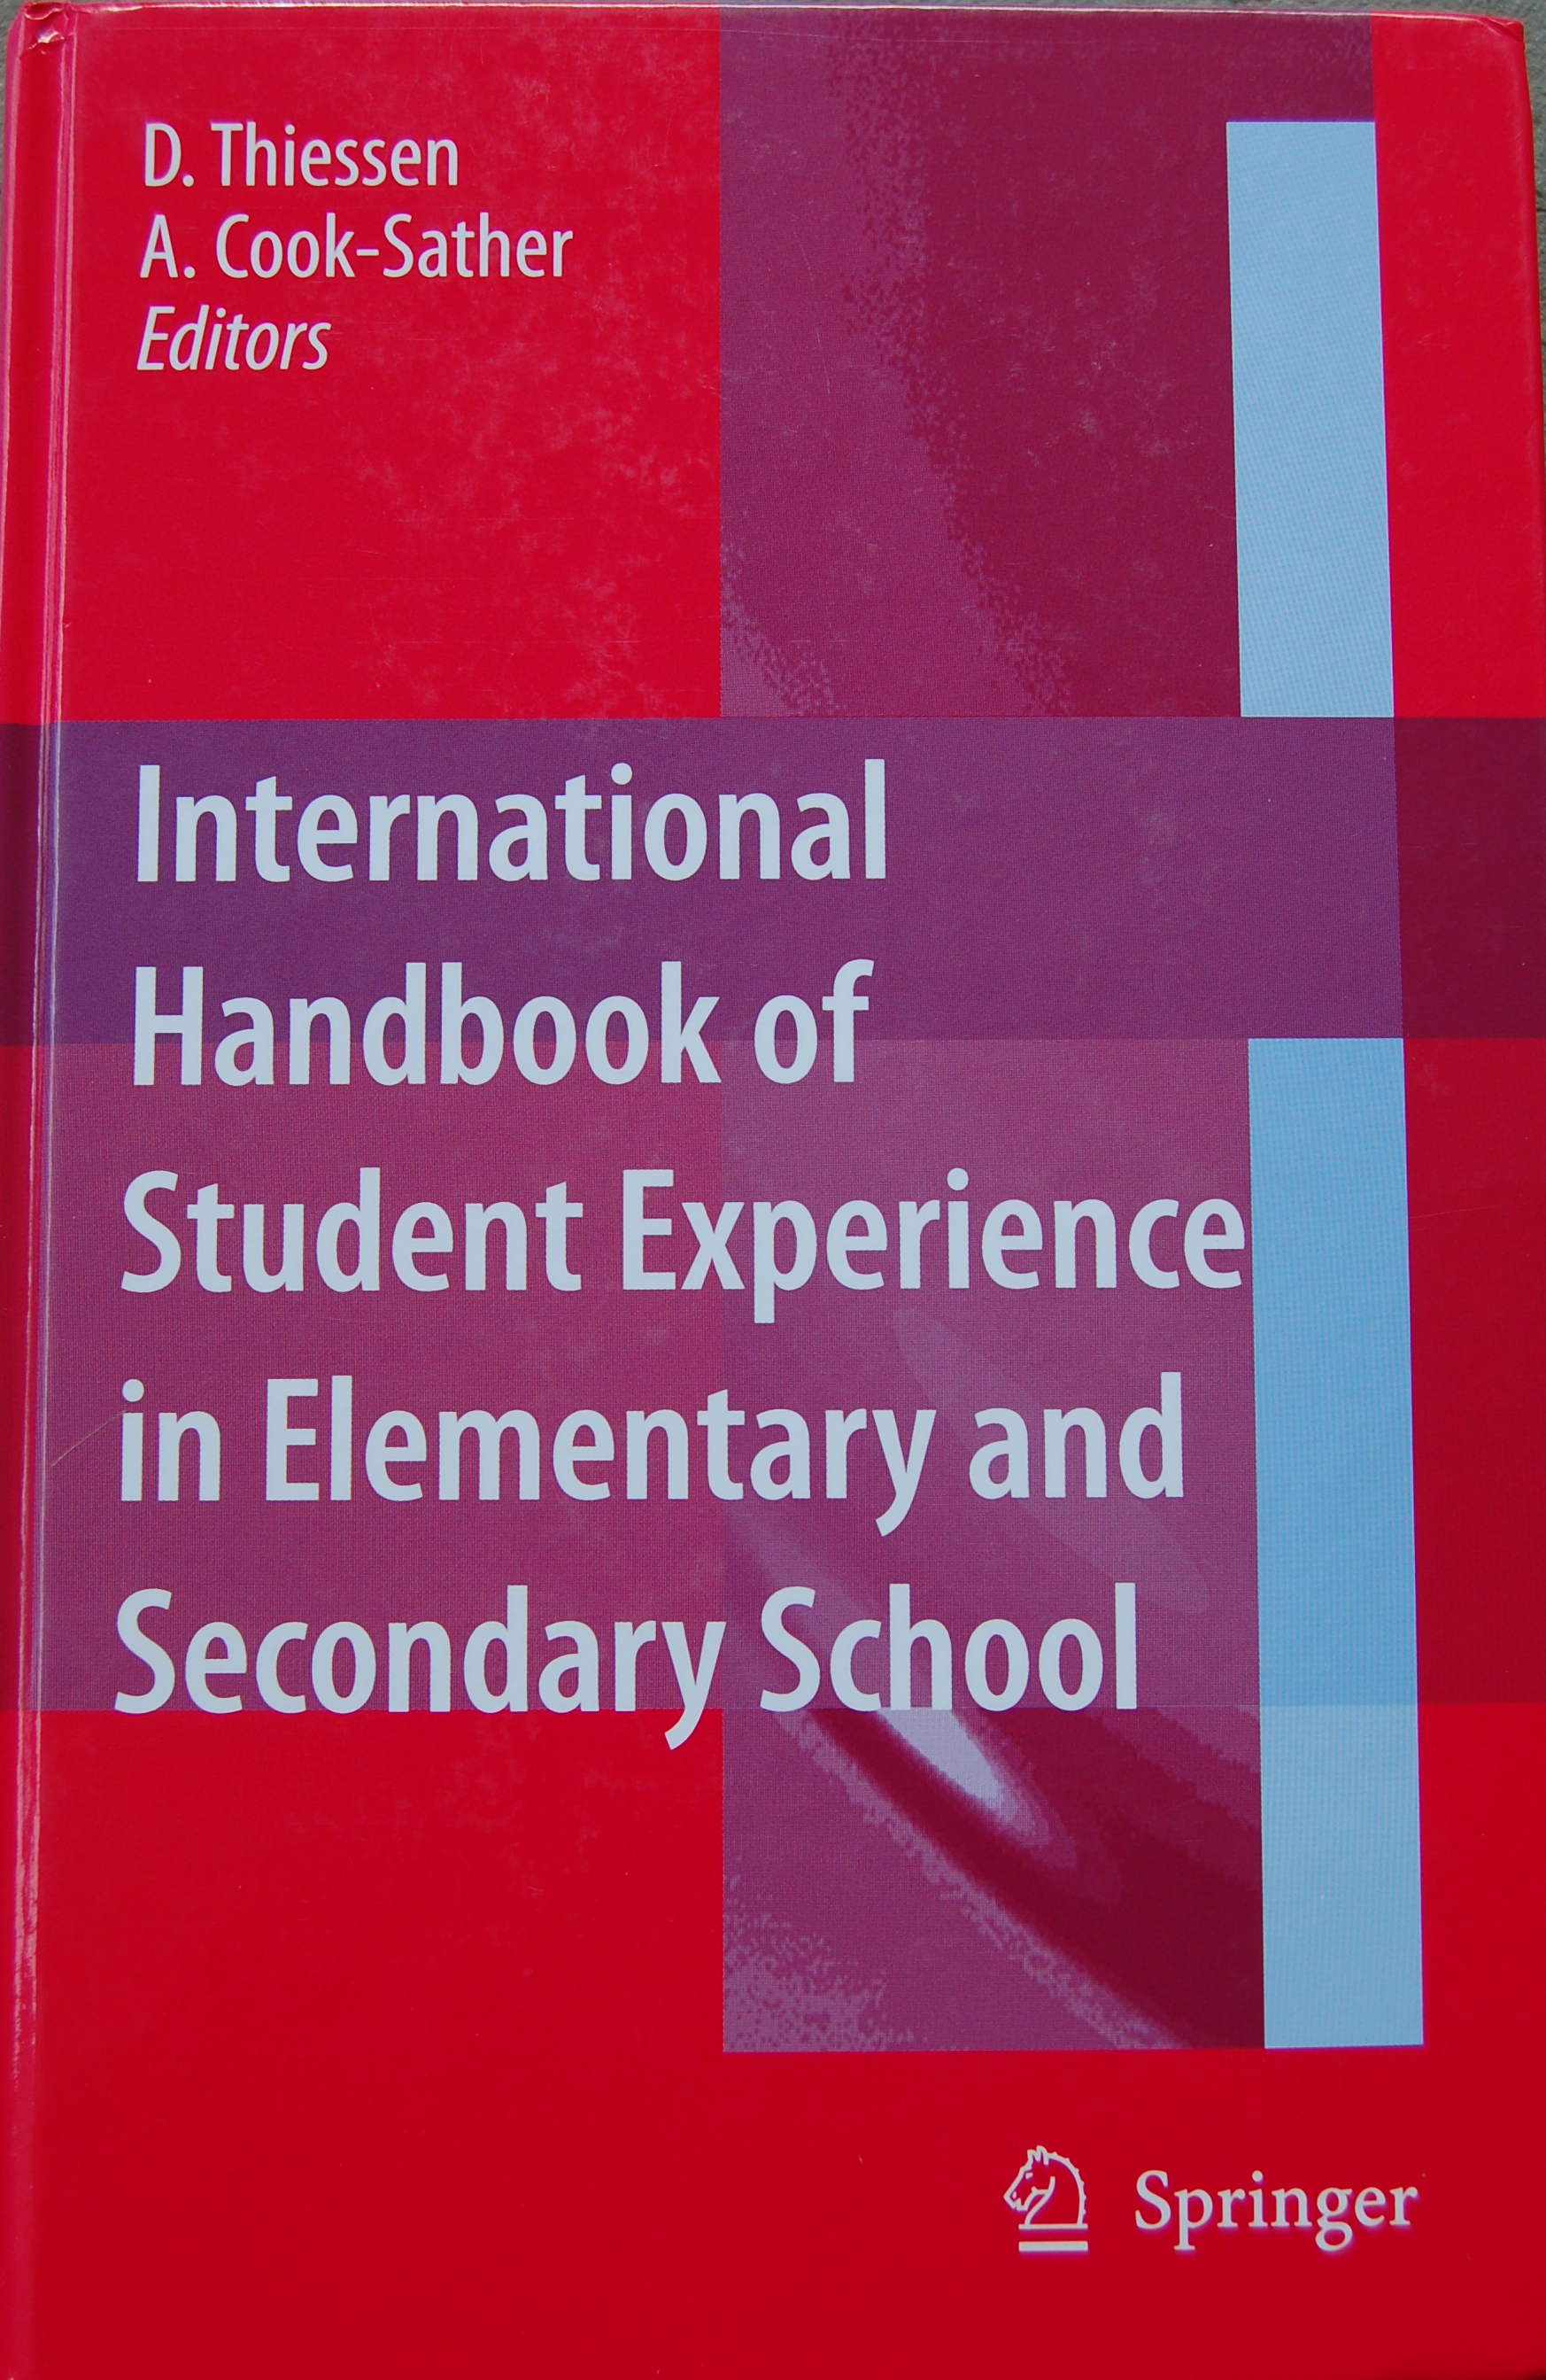
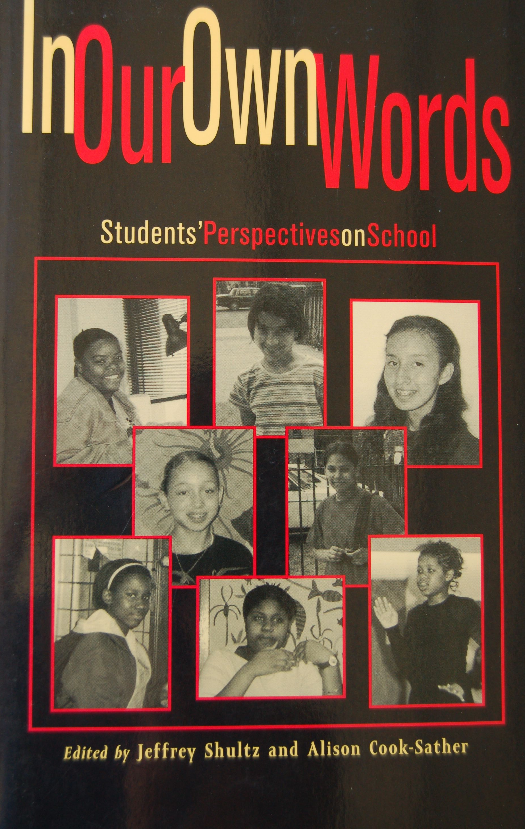
“Change Based On What Students Say”: Preparing Teachers for a More Paradoxical Model of Leadership, International Journal of Leadership in Education, 2006.
Resisting the Impositional Potential of Student Voice Work: Lessons for Liberatory Educational Research from Poststructuralist Feminist Critiques of Critical Pedagogy. Discourse , 2007.
Authorizing Students’ Perspectives: Toward Trust, Dialogue, and Change in Education. Educational Researcher, 2002.
Sound, Presence, and Power: Exploring “Student Voice” in Educational Research and Reform.
Curriculum Inquiry, 2003.
Movements of Mind: The Matrix, Metaphors, and Re-Imagining Education. Teachers College Record, 2003.
“I Want to Listen to My Students’ Lives”: Developing an Ecological Perspective in Learning to Teach. With Heather Curl. Teacher Education Quarterly, Winter, 2015.
The “Constant Changing of Myself”: Revising Roles in Undergraduate Teacher Preparation. The Teacher Educator , 2006.
Re(in)forming the Conversations: Student Position, Power, and Voice in Teacher Education. Radical Teacher , 2002.
“I Am Not Afraid to Listen”: Prospective Teachers Learning from Students to Work
in City Schools. Theory into Practice. [Themed Issue: Urban Youth. 2009].

Slide 9
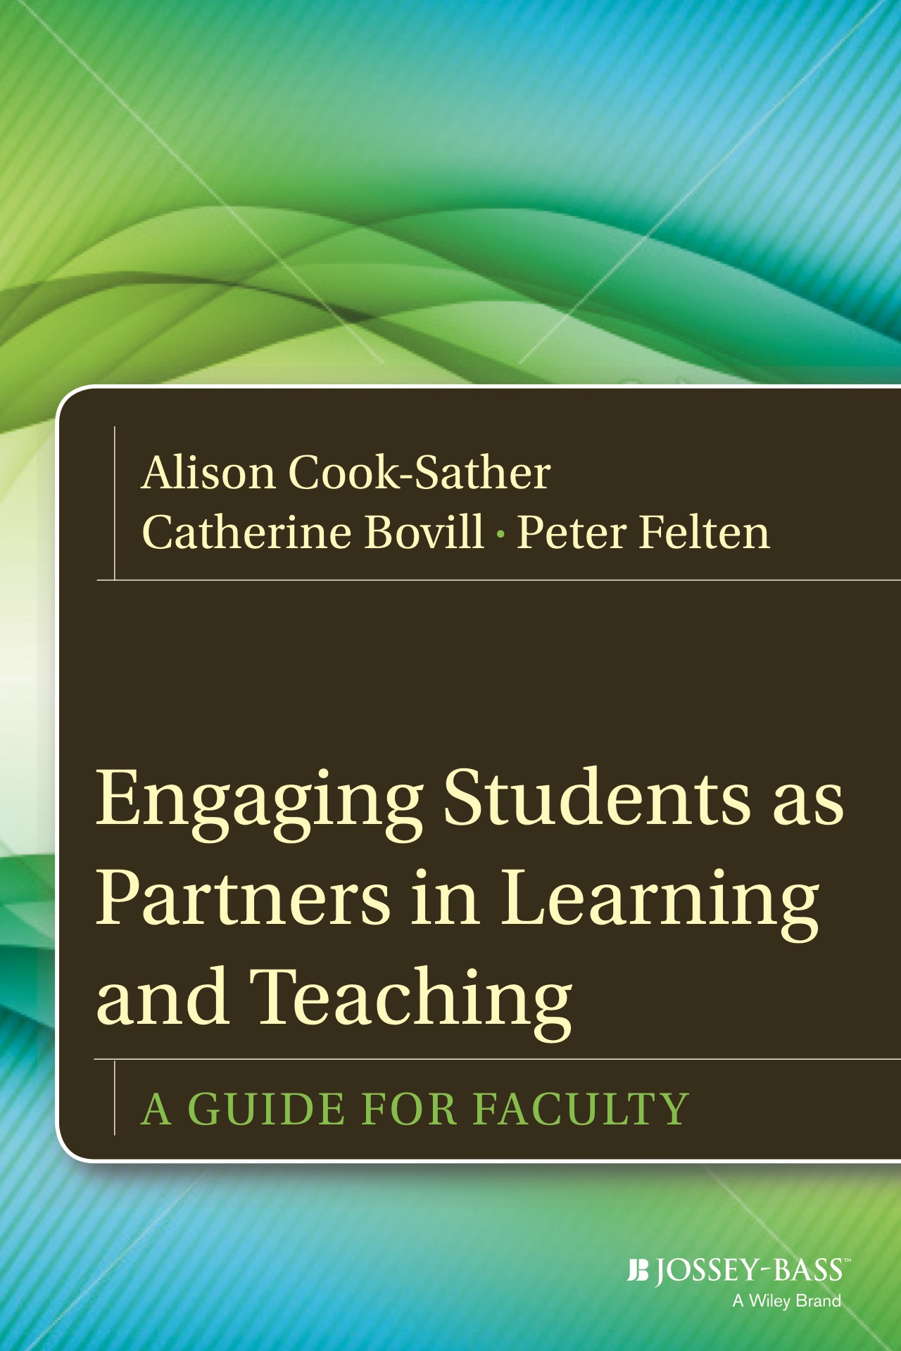
Dialogues Across Differences of Position, Perspective, and Identity: Reflective Practice In/On a Student-Faculty Pedagogical Partnership Program. Teachers College Record, 2015.
Undergraduate Students as Partners in New Faculty Orientation and Academic Development. International Journal of Academic Development, 2016.
Greater Engagement in and Responsibility for Learning: What Happens When Students Cross the Threshold Of Student-Faculty Partnership. With Alia Luz. Higher Education Research & Development, 2014.
What Is and What Can Be: How a Liminal Position Can Change Learning and Teaching in Higher Education. With Zanny Alter. Anthropology & Education Quarterly, 2011.
Layered Learning: Student Consultants Deepening Classroom and Life Lessons. Educational Action Research, 2011.
Students of Color and Faculty Members Working Together Toward Culturally Sustaining Pedagogy. With Praise Agu. To Improve the Academy: A Journal of Educational Development, 2013.
Mapping Classroom Interactions: A Spatial Approach to Analyzing Patterns of Student Participation. With Sophia Abbot and Carola Hein. To Improve the Academy: A Journal of Educational Development, 2014.
“What You Get Is Looking in a Mirror, Only Better”: Inviting Students to Reflect (on) College Teaching. Reflective Practice, 2008.
Addressing Potential Challenges in Co-Creating Learning and Teaching: Overcoming Resistance, Navigating Institutional Norms and Ensuring Inclusivity in Student–Staff Partnerships. With Catherine Bovill, Peter Felten, Luke Millard, and Niamh Moore-Cherry. Higher Education, 2016.
From Traditional Accountability to Shared Responsibility: The Benefits and Challenges of Student Consultants Gathering Midcourse Feedback in College Classrooms. Assessment & Evaluation in Higher Education, 2009.

Slide 10
Toward ongoing growth of roots and branches…..

