Slide 1
Alterations of Habitable Pore Space By Earthworms and Subsequent Effects on Soil Biogeochemistry
Josef H. Görres¹ and José A. Amador²
University of Vermont; 2. University of Rhode Island

Slide 2
Earthworms and carbon headlines from the literature
Lubbers, Ingrid M., et al. "Greenhouse-gas emissions from soils increased by earthworms." Nature Climate Change 3.3 (2013): 187-194.
Van Groenigen, Jan Willem, et al. "Earthworms increase plant production: a meta-analysis." Scientific reports 4 (2014): 6365.
Zhang, Weixin, et al. "Earthworms facilitate carbon sequestration through unequal amplification of carbon stabilization compared with mineralization." Nature communications 4 (2013): 2576.
Knowles, Meghan E. et al. "Effect of the endogeic earthworm Aporrectodea tuberculata on aggregation and carbon redistribution in uninvaded forest soil columns." Soil Biology and Biochemistry 100 (2016): 192-200.

Slide 3
Effect of earthworms in a dynamic habitat context
Could earthworms regulate interactions in the soil food web involved in carbon and nitrogen mineralization?
  Drilosphere = Resource Islands
Do earthworms create habitable pore space to promote microbivory?
  Overlap between the habitats of microorganisms and their aquatic grazers (nematodes and protozoa)

Slide 4
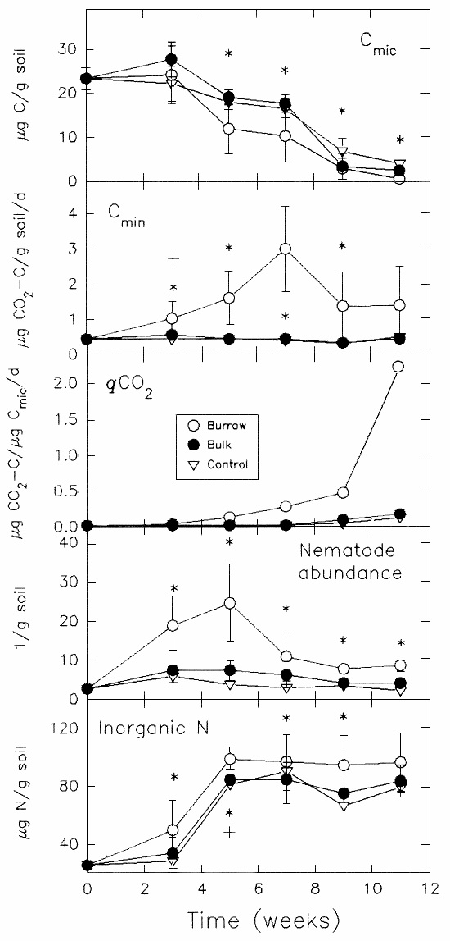
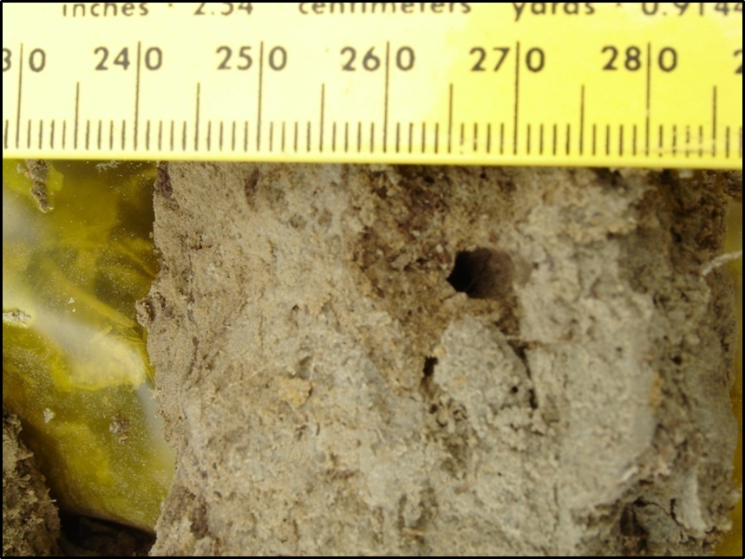
Evidence for earthworm effects on soil biogeochemistry from a mesocosm experiment
In presence of L. terrestris
  microbial biomass was suppressed
  C-mineralization increased
  Nematode abundance increased
  Inorganic N increased
Mesocosm experiment, 11 weeks incubation
Comparison of bulk and burrow soil
Görres, Josef H., Mary C. Savin, and José A. Amador. "Dynamics of carbon and nitrogen mineralization, microbial biomass, and nematode abundance within and outside the burrow walls of anecic earthworms (Lumbricus terrestris)." Soil Science 162.9 (1997): 666-671.

Slide 5
The role of micro- and mesofauna in mineralization
Mineral nutrient pool
-
Grazing: Direct Effect on microbial biomass
Detritus
Active microbial biomass
Micro-&Mesofauna
+
Regulated by overlap of habitats
Compensatory growth: Density
dependent effect on microbial
biomass
Microbivory accelerates decomposition
and mineralization

Slide 6
The concept of a variable habitable pore space: soil moisture varies
Soil: two parallel universes
Organisms have to fit into spaces
Aquatic world
  Nematodes
  Protozoa
Aerated world
  Mites
  Collembola
Water-filled pore spaces
  Pore diameters
  Pore volume
  Micro- and mesopores
Air-filled pore spaces
  Pore diameters
  Pore volume
  Macropores
Almost
impenetrable
Suggested readings: Elliott, Edward T., et al. "Habitable pore space and microbial trophic interactions." Oikos (1980): 327-335.
Griffiths, B. S. "Microbial-feeding nematodes and protozoa in soil: Their effects on microbial activity and nitrogen mineralization in decomposition hotspots and the rhizosphere." Plant and Soil 164.1 (1994): 25-33.
Wardle D A and Yeates G W 1993 The dual importance of competition and predation as regulatory forces in terrestrial ecosystems:evidence from decomposer food-webs. Oecologia 93, 303–306.
Linn, Daniel Myron, and John W. Doran. "Effect of water-filled pore space on carbon dioxide and nitrous oxide production in tilled and nontilled soils 1." Soil Science Society of America Journal 48.6 (1984): 1267-1272.

Slide 7
Two pore models
Mobile-immobile water model:
Enclosure Hypothesis: organisms may become enclosed in aggregates as soil dries.
Parallel capillary bundle model:
Exclusion hypothesis: Aquatic organisms have to fit into water-filled capillaries and become excluded when capillaries dry up.
Creature
Most like: Hassink, J., et al. "Relationships between habitable pore space, soil biota and mineralization rates in grassland soils." Soil Biology and Biochemistry 25.1 (1993): 47-55.
Most like: Hattori, R., and T. Hattori. "Soil aggregates as microcosms of bacteria–protozoa biota." Soil Structure/Soil Biota Interrelationships. Elsevier, 1993. 493-501.

Slide 8
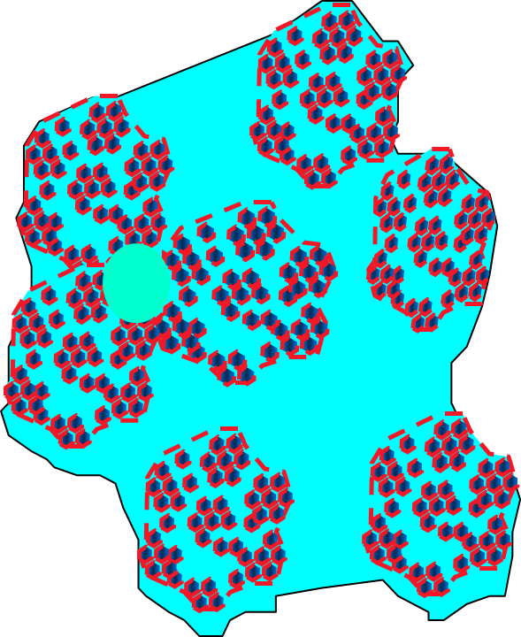
The premise of the Enclosure Hypothesis:
Trade off between habitat space available and expended energy to find food.
Lots of habitat but large diffusion/search distances
Less habitat but short diffusion/search distances
Consequences
If drier soil, more efficient grazing
  Active microbial biomass
  More CO₂ evolved
Diffusion of N
  More mineralization but also
  More immobilization as N can’t leave the enclosures
  Net N mineralization low
Also have a look at Drury, C. F., R. P. Voroney, and E. G. Beauchamp. "Availability of NH4+-N to microorganisms and the soil internal N cycle." Soil Biology and Biochemistry 23.2 (1991): 165-169.
Young I M, Roberts A, Griffiths B S and Caul S 1994 Growth of aciliate protozoan in model Ballotini systems of different particlesizes. Soil Biol. Biochem. 26, 1173–1178.
Water-filled space

Slide 9
Pore Size Modifications by Earthworms: Experimental Set Up
1 weeks
3
5
7
10
13
16
Mesocosms, 15-cm diam. X 30-cm length
16 weeks of incubation
Aggregates taken for mercury porosimetry after 1, 3, 5 and 16 weeks of incubation, plus an initial sample
Drilosphere: within 0.5 mm of the burrow
Bulk: at least 5 cm from nearest burrow
Compared intrusion pore size distribution
Aggregates were approximately 5 mm in diameter.
Anecic worm
burrow
Worm
+ O₂ diffusion
+ Resources in
Burrow

Slide 10
How is Aggregate Structure expressed in Mercury Porosimetry
Pore necks
Volume intruded
Pore chambers
Pressure Applied

Slide 11
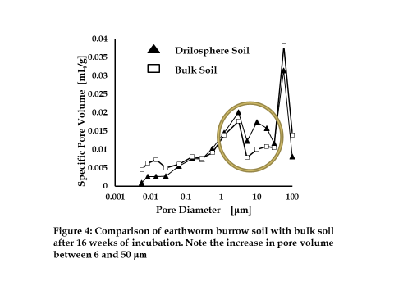
Link to pore size distribution with microbivorous nematode body diameter distribution
Gorres, J.H. and Amador, J.A., 2010. Partitioning of habitable pore space in earthworm burrows. Journal of nematology, 42(1), p.68.

Slide 12
Does drilosphere of different earthworms contain different habitable pore space?
No earthworms
Amynthas spp.
L. terrestris
Gorres and Amador. Unpublished data

Slide 13
Does pore structure affect C mineralization?
Field collection of aggregates from
  Excavation mounts (middens) of L. terrestris
  Burrows of L. terrestris
  Bulk soil at least 5 cm away from the burrow
Incubated the aggregates in scintillation vials
Measured CO₂ evolution
Then measured the intrusion pore size distribution
Analyzed CO₂ as a function of pore size distribution, intrusion volume per g of soil

Slide 14
Carbon mineralization versus porosity parameters
Gorres, Josef H., Mary C. Savin, and José A. Amador. "Soil micropore structure and carbon mineralization in burrows and casts of an anecic earthworm (Lumbricus terrestris)." Soil Biology and Biochemistry 33.14 (2001): 1881-1887.

Slide 15
Conclusions
Earthworms have an effect on CO₂ evolution from soils
Part of this effect is due to increased resources in drilosphere that promote the growth of microorganisms and their grazers
But, the effect may be regulated by the access of microbivores to microorganisms through pore alterations, and how closely they are located to each other (distance between grazer and forage).
Experiment needed that directly tests the convolution of physical and biological constraints in the drilosphere
Maybe check out the genetic diversity in at different levels of aggregate hierarchy (for cool ideas read: Chenu, C., Hassink, J. and Bloem, J., 2001. Short-term changes in the spatial distribution of microorganisms in soil aggregates as affected by glucose addition. Biology and Fertility of Soils, 34(5), pp.349-356. and Currie, J. A. "The volume and porosity of soil crumbs." Journal of Soil Science 17.1 (1966): 24-35; Sexstone, A.J., Revsbech, N.P., Parkin, T.B. and Tiedje, J.M., 1985. Direct measurement of oxygen profiles and denitrification rates in soil aggregates 1. Soil science society of America journal, 49(3), pp.645-651.
PHYSICS MATTERS

Slide 16
Acknowledgements
This research was funded by the USDA’s National Research Initiative and The Agricultural Experiment Stations of the University of Rhode Island and the University of Vermont.
Special thanks to Mary Savin for her contributions to this research, and the many undergraduates at URI that helped with the research (M. Dichiaro, K. Conde, S. Barron, S. Aubois, J. Joyal)

Slide 17
Cool readings at a glance: papers that peeked our interest
Lubbers, Ingrid M., et al. "Greenhouse-gas emissions …" Nature Climate Change 3.3 (2013): 187-194.
Van Groenigen, Jan Willem, et al. "Earthworms increase plant production ..." Scientific reports 4 (2014): 6365.
Zhang, Weixin, et al. "Earthworms facilitate carbon sequestration …" Nature communications 4 (2013): 2576.
Knowles, M.E. et al. "Effect of the … earthworm …. carbon redistribution …." Soil Biol. Biochem 100 (2016): 192-200
Görres, J. "Dynamics of carbon … mineralization, ... biomass, and nematode abundance within … outside the burrow walls of … (L. terrestris)." Soil Science 162.9 (1997): 666-671.
Elliott, Edward T., et al. "Habitable pore space and microbial trophic interactions." Oikos (1980): 327-335.
Griffiths, B. S. "Microbial-feeding nematodes and protozoa in soil: …. microbial activity … decomposition hotspots and the rhizosphere." Plant and Soil 164.1 (1994): 25-33.
Wardle D A and Yeates G W 1993 The dual importance of competition and predation as regulatory forces in terrestrial ecosystems: … Oecologia 93, 303–306.
Linn, Daniel Myron, and John W. Doran. “….water-filled pore space on carbon dioxide and nitrous oxide …." Soil Science Society of America Journal 48.6 (1984): 1267-1272.
Hassink, J., et al. "Relationships between habitable pore space, soil biota and mineralization rates in grassland soils." Soil Biology and Biochemistry 25.1 (1993): 47-55.
Drury, C. F., R. P. Voroney, and E. G. Beauchamp. "Availability of NH4+-N to microorganisms and the soil internal N cycle." Soil Biology and Biochemistry 23.2 (1991): 165-169.
Young I M, Roberts A, Griffiths B S and Caul S 1994 Growth of aciliate protozoan in model Ballotini systems of different particlesizes. Soil Biol. Biochem. 26, 1173–1178.
Gorres, J.H. and Amador, J.A., 2010. Partitioning of habitable pore space in earthworm burrows. Journal of nematology, 42(1), p.68.
Görres, J.H., et al. "Grazing in a porous environment: 1. The effect of soil pore structure on C and N mineralization." Plant and Soil 212 (1999): 75-83.
Hattori, R., and T. Hattori. "Soil aggregates as microcosms of bacteria–protozoa biota." Soil Structure/Soil Biota Interrelationships. Elsevier, 1993. 493-501.
Chenu, C., Hassink, J. and Bloem, J., 2001. Short-term changes in the spatial distribution of microorganisms in soil aggregates ... Biol. and Fert. of Soils, 34(5), pp.349-356.
Currie, J. A. "The volume and porosity of soil crumbs." Journal of Soil Science 17.1 (1966): 24-35
Sexstone, A.J., Revsbech, N.P., Parkin, T.B. and Tiedje, J.M., 1985. … oxygen profiles and denitrification … soil aggregates 1. Soil science society of America journal, 49(3), pp.645-651
Quénéhervé P, Chotte J-L. Distribution of nematodes in vertisol aggregates under a permanent pasture in Martinique. Applied Soil Ecology. 1996;4:193–200.
Sano Z-I, Nakasono K. Influence of size of soil aggregates on the survival of Meloidogyne incognita juveniles. Soil Microorganisms. 1997;49:9–16.
Yeates GW, Dando JL, Shepherd TG. Pressure plate studies-… how moisture affects access of … nematodes to food in soil. European Journal of Soil Science. 2002;53:355–365..
Groffman, Peter M., and James M. Tiedje. "Denitrification hysteresis during wetting and drying cycles in soil." Soil Science Society of America Journal 52.6 (1988): 1626-1629.
And many more

